Slide 1
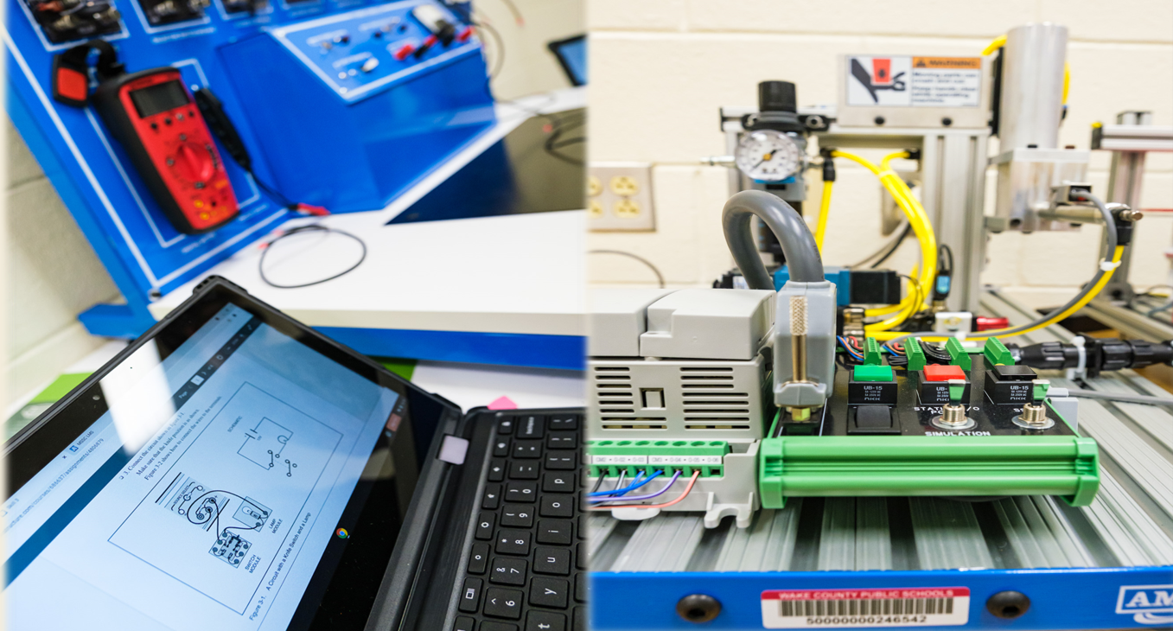
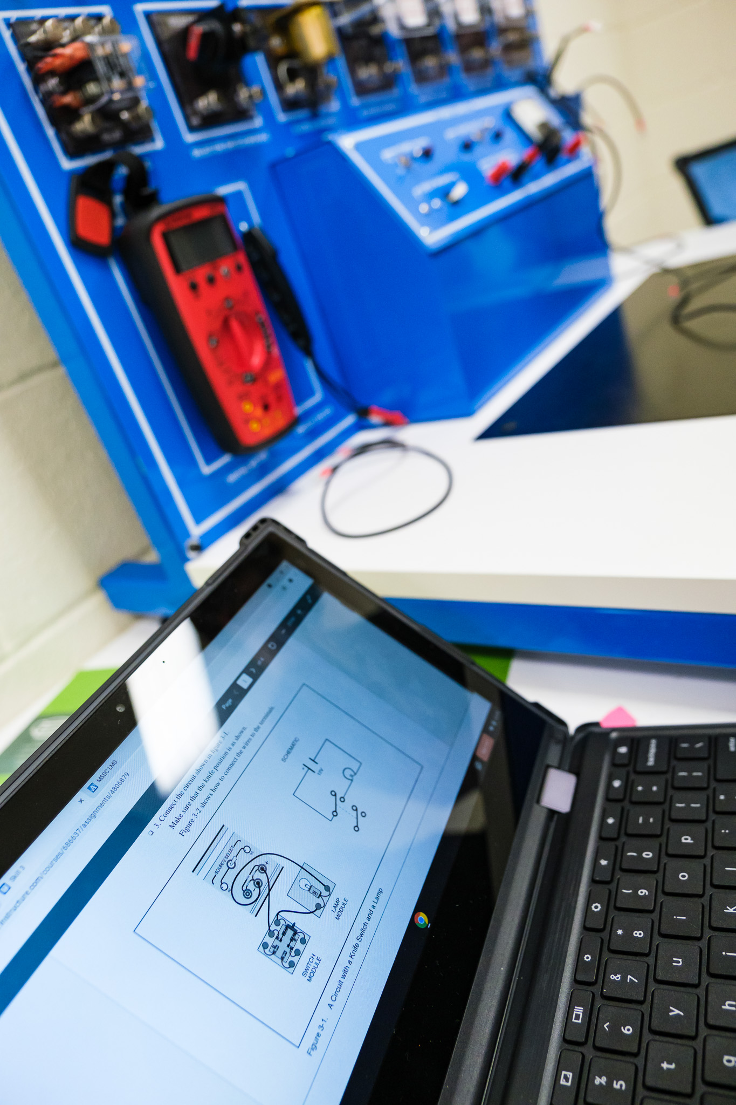
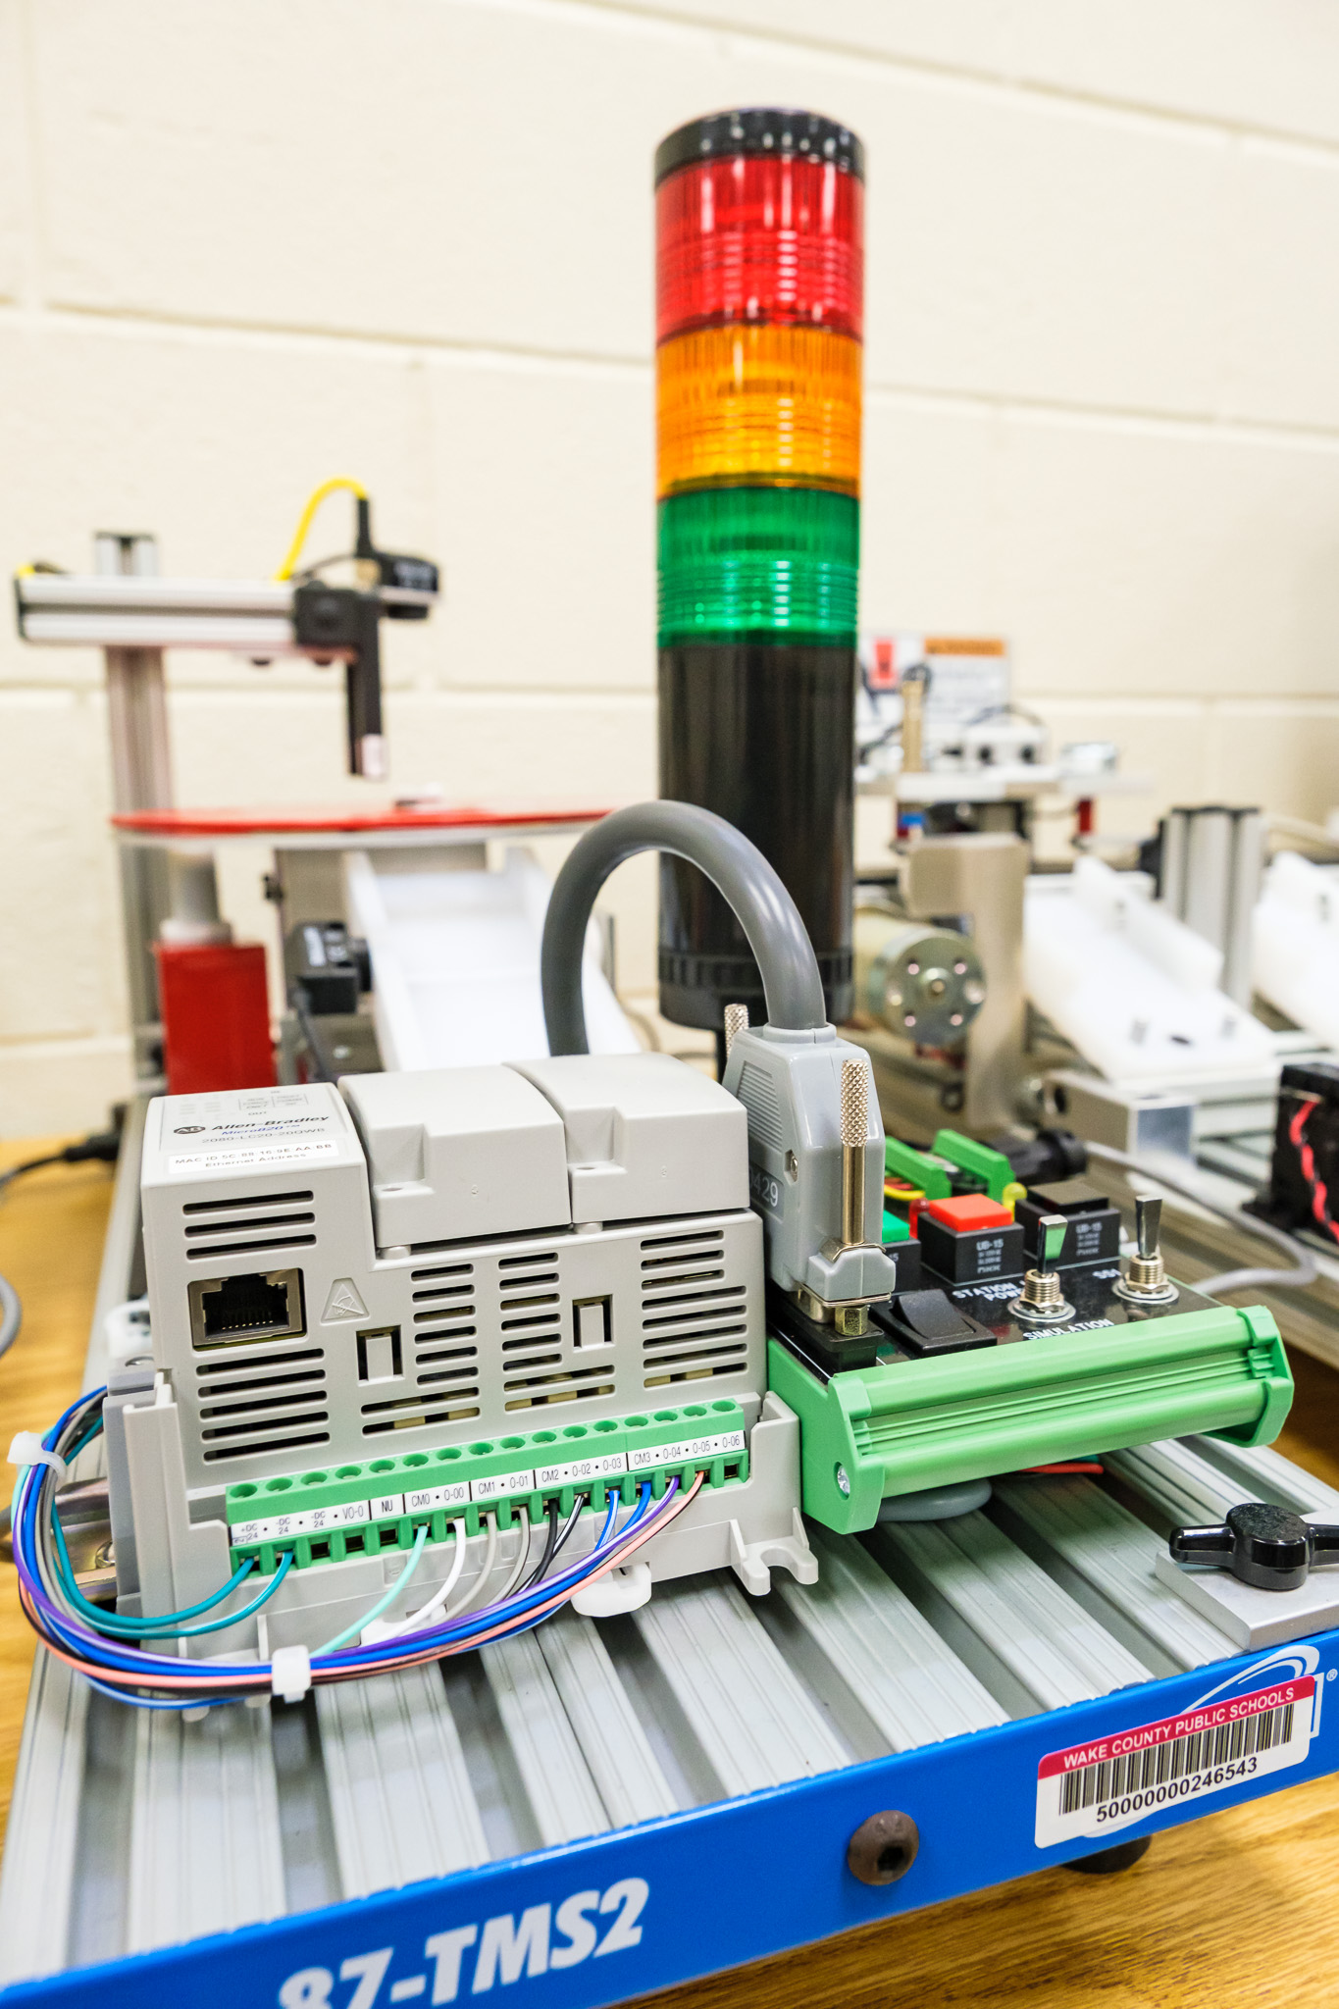

Slide 2
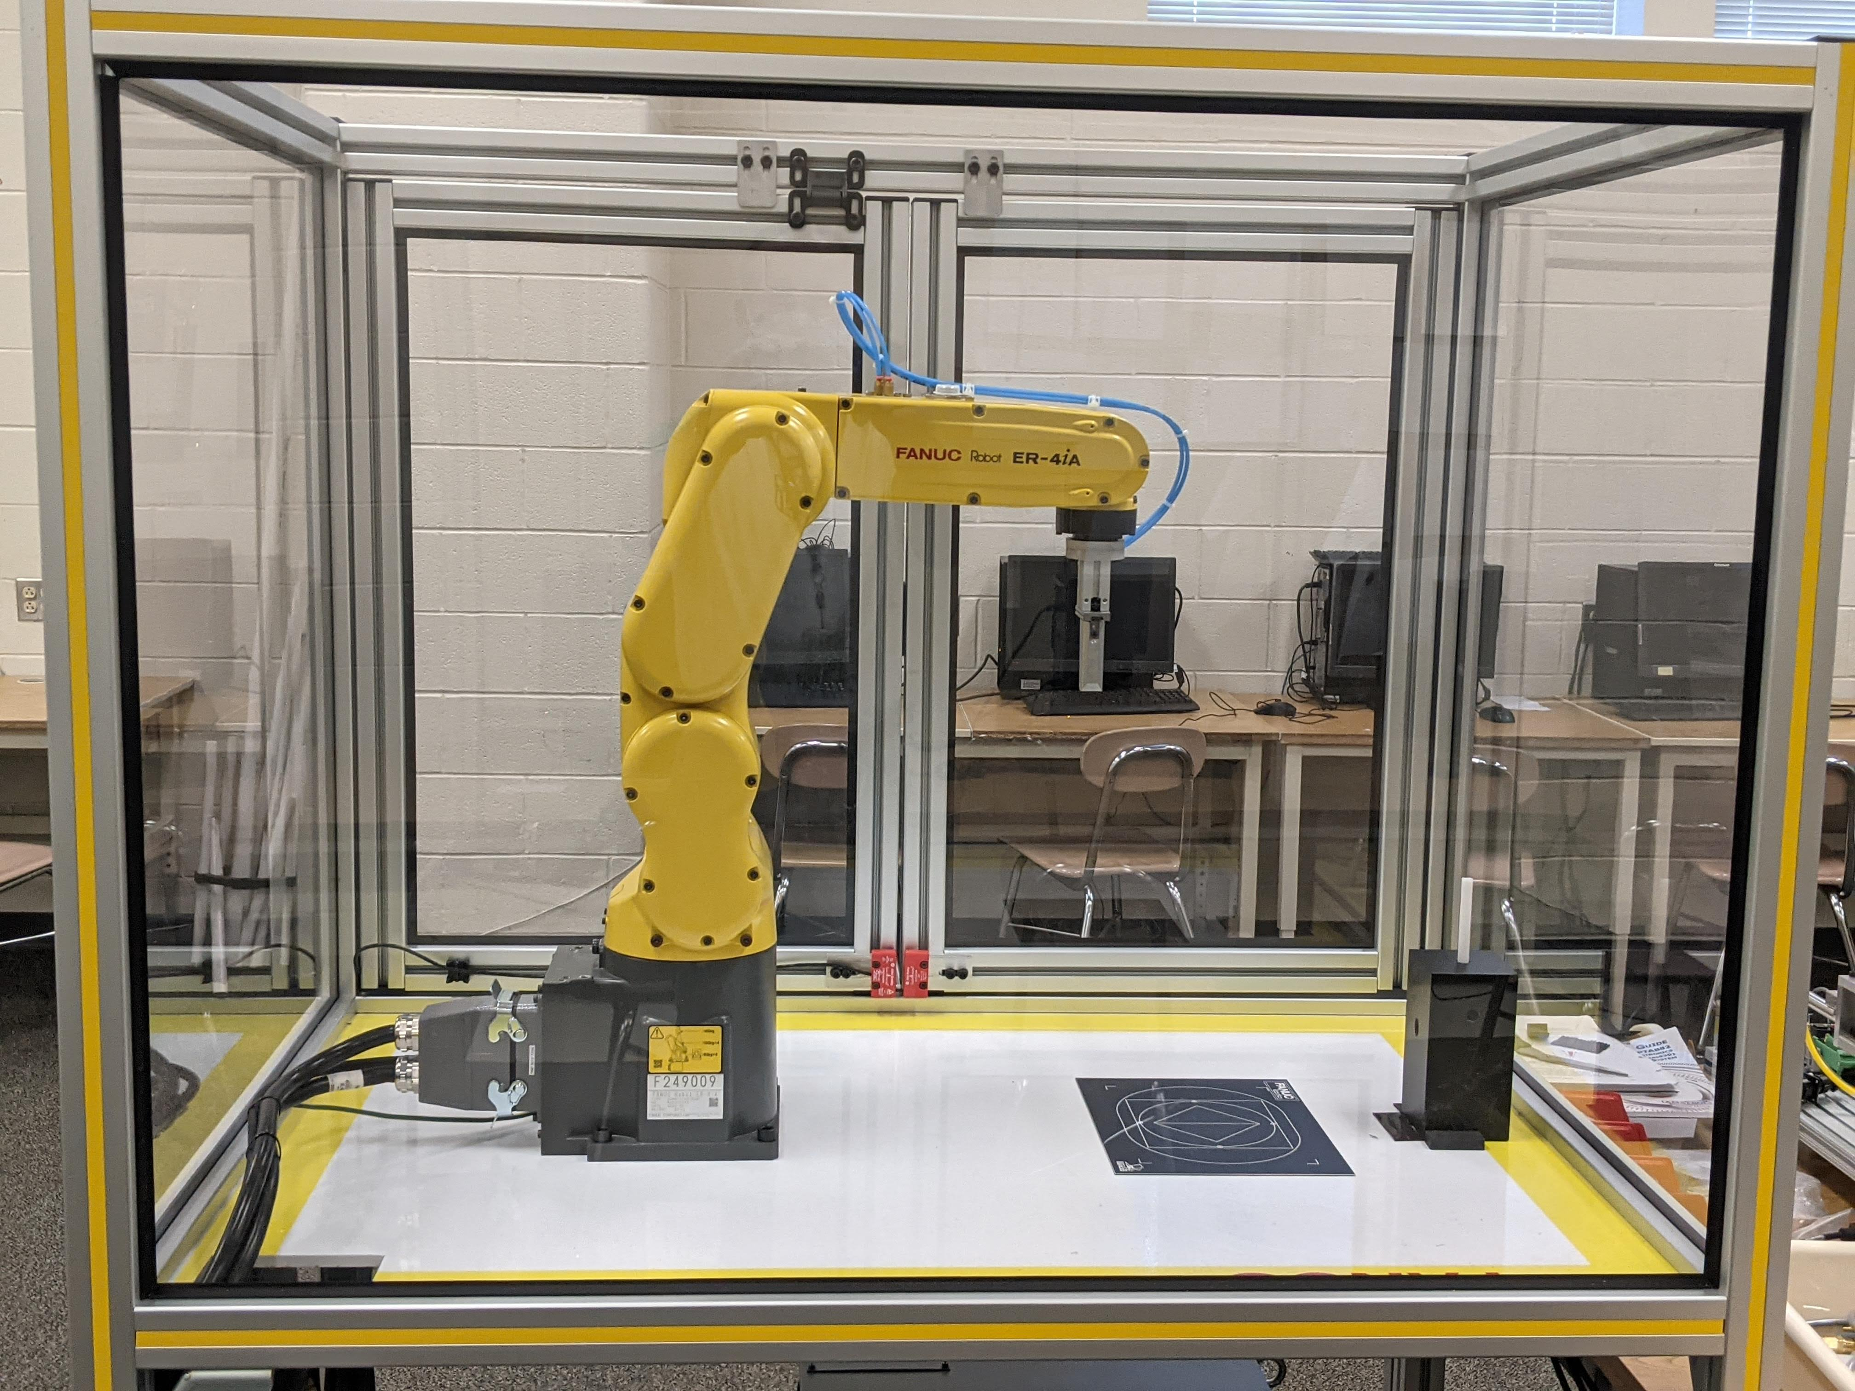
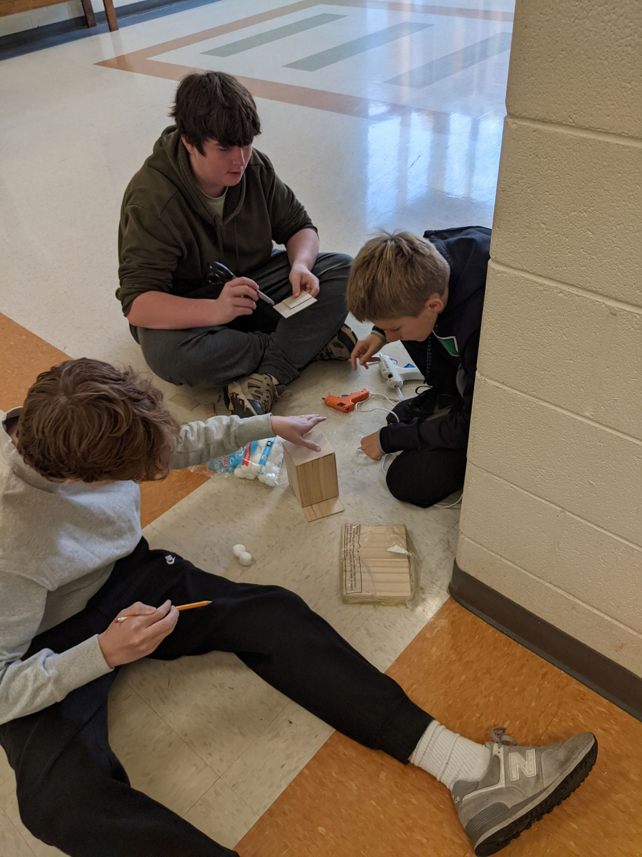
What is the Academy of Technology & Advanced Manufacturing(ATAM)
?

Slide 3
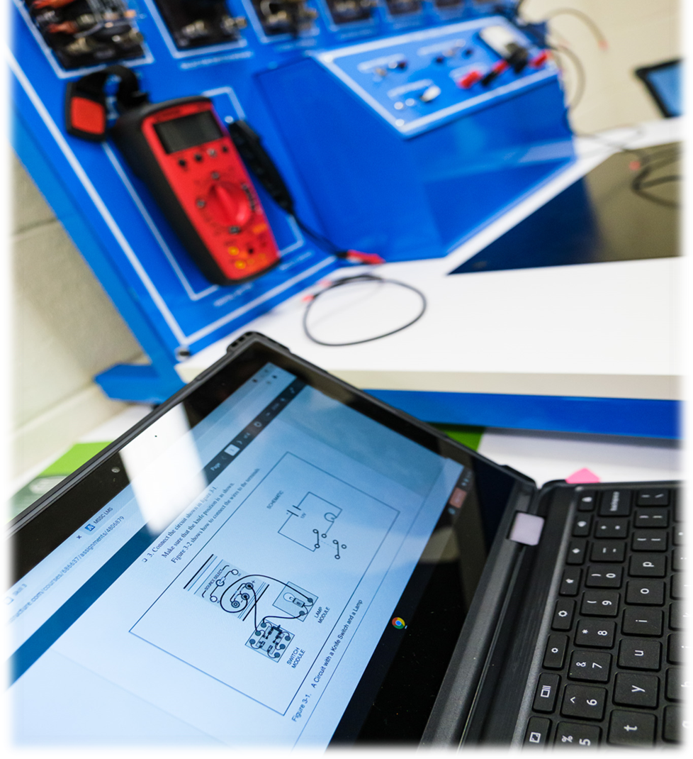
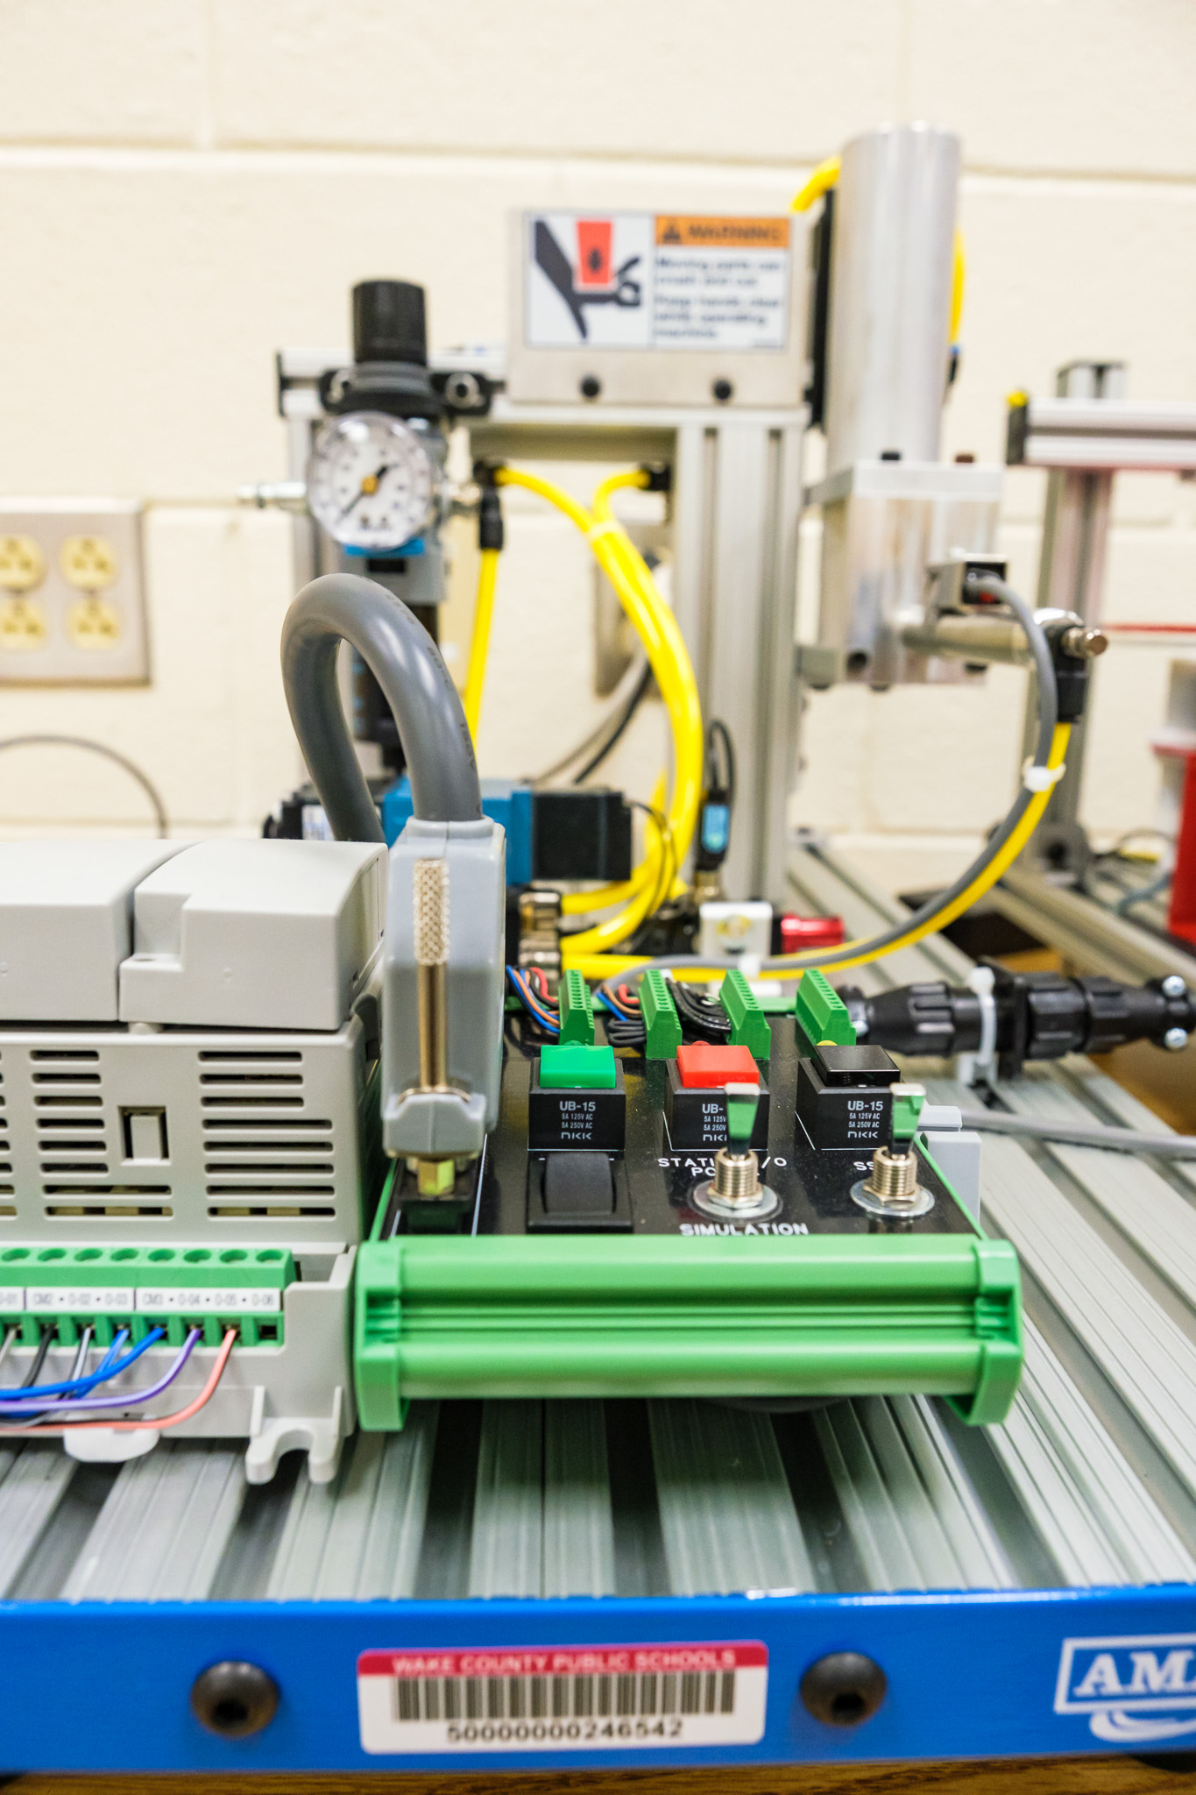
An Opportunity And More For Cary High Students!!

Slide 4
What is ATAM?
Cary High School ATAM is new smaller inclusive learning community within Cary High School that focuses on preparing students for careers in today's highly skilled workforce. Student cohorts take Career and Technical Education and core classes together.
Dual Tract curriculum pathways in Engineering/Technology and Advanced Manufacturing.
Twenty first century workplace, employability and soft skills are integrated throughout the program(Resume Writing, Mock Interviews, Networking, Job Shadows, Business Immersions,…etc.).
The program uses the integration of STEM principles, interdisciplinary, and co-curricular collaborative projects to prepare students for life and the workplace
Emphasis is placed on problem-solving, presentations, communication, teamwork, technology and employability skills
Academy Director – John Evans
Email: jevans3@wcpss.net
Cary High School
919 460-3549 Ext. 21832

Slide 5
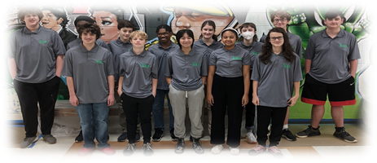
What is ATAM?
Academy acts as a bridge from the school system to the workplace
Internship/Apprenticeship model – NCTAP and local business
Employment opportunities upon graduation – Local business
Outstanding preparation for college
Career academies, educators, and the business community become partners investing in and developing today’s youth
Academy Director – John Evans
Email: jevans3@wcpss.net
Cary High School
919 460-3549 Ext. 21832

Slide 6
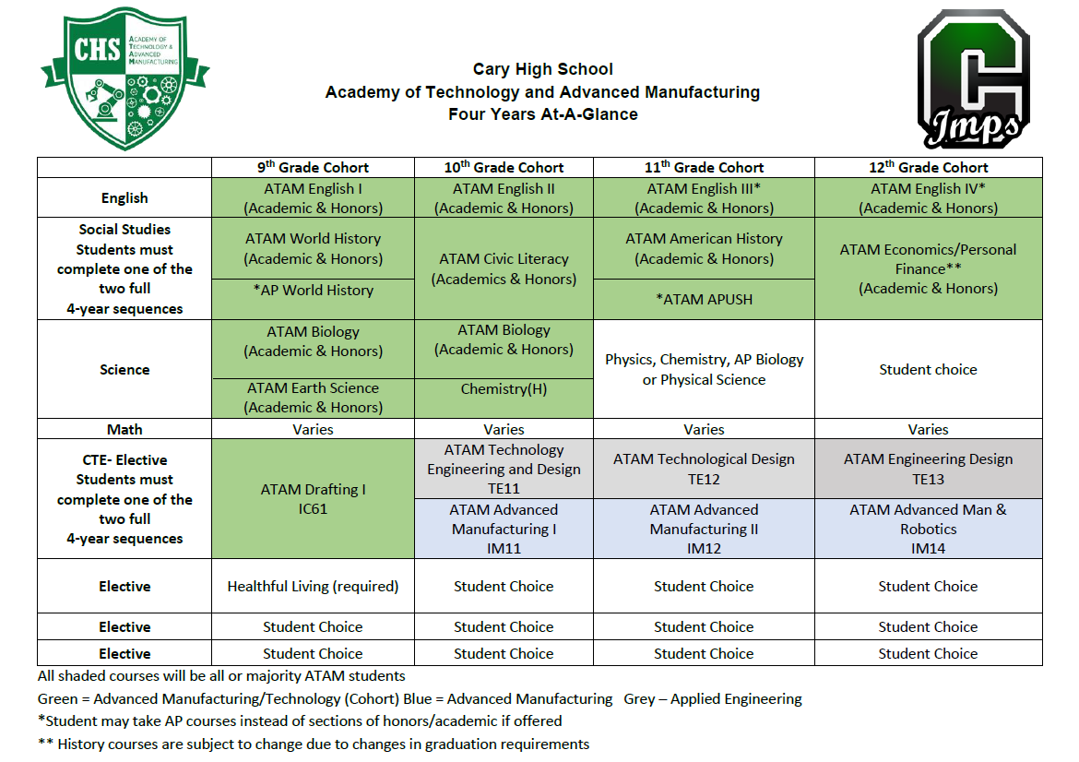

Slide 7
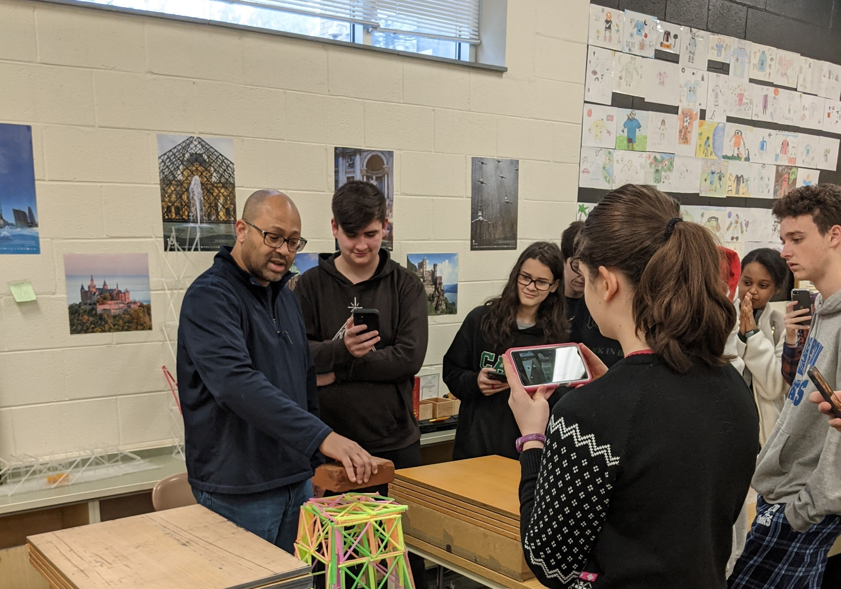
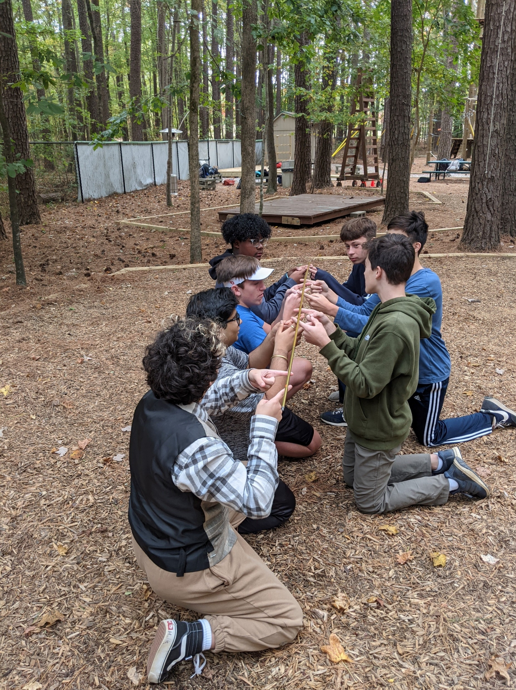
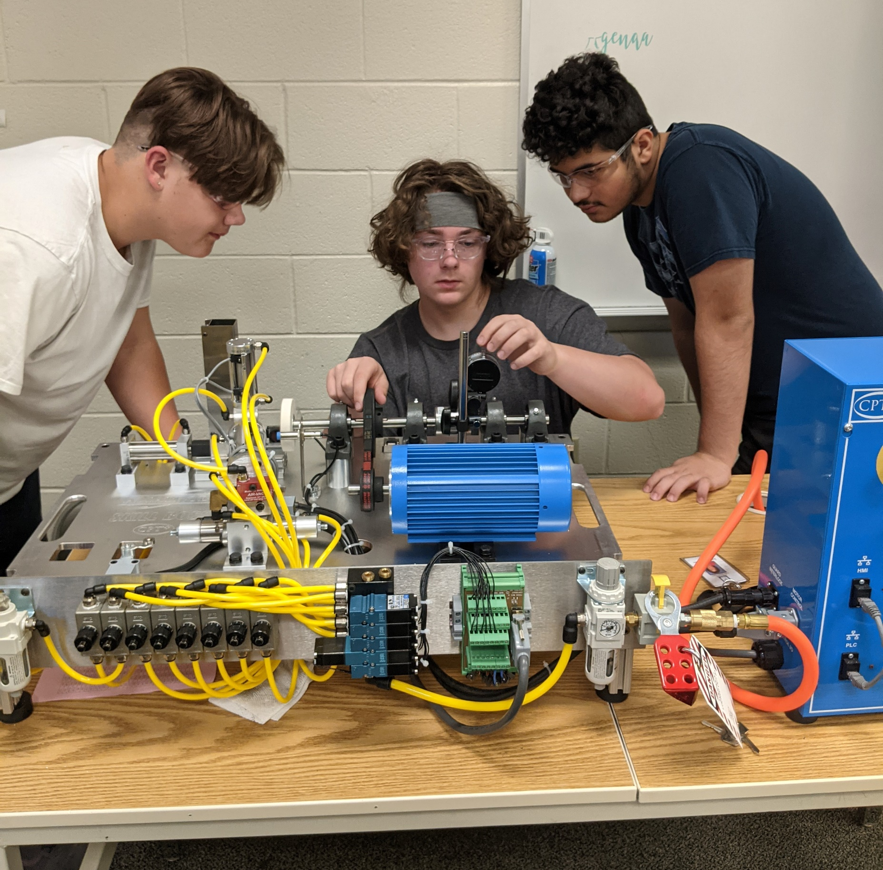
Opportunity for your child to be Part of:
A learning environment that is collaborative and fun!!
A group that has strong relationships with their teachers & peers!!
A small learning community where students have built-in support!!

Slide 8
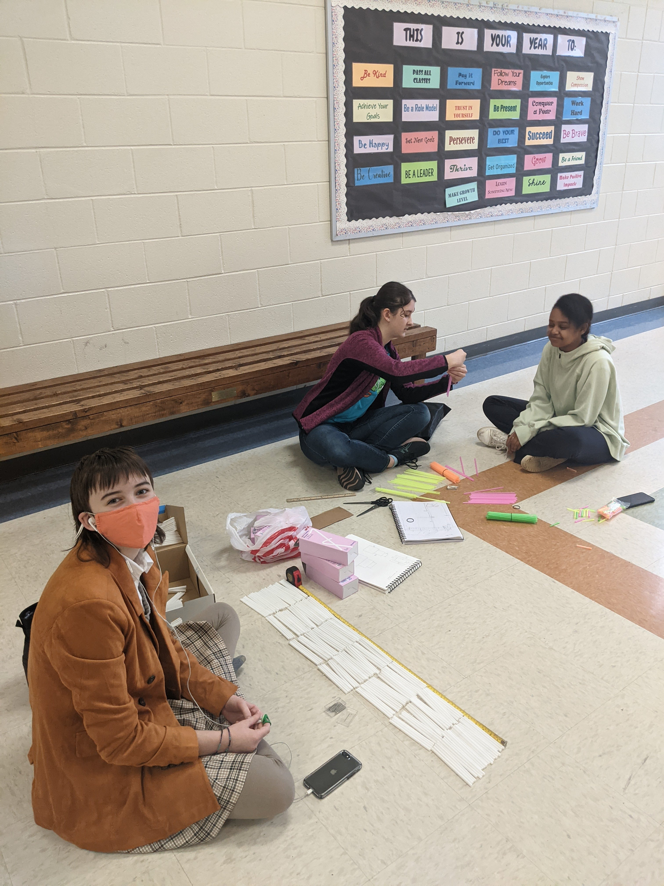
Drafting 1 Bridge Competition

Slide 9
Drafting 1 Bridge Competition

Slide 10
Drafting 1 Bridge Competition

Slide 11
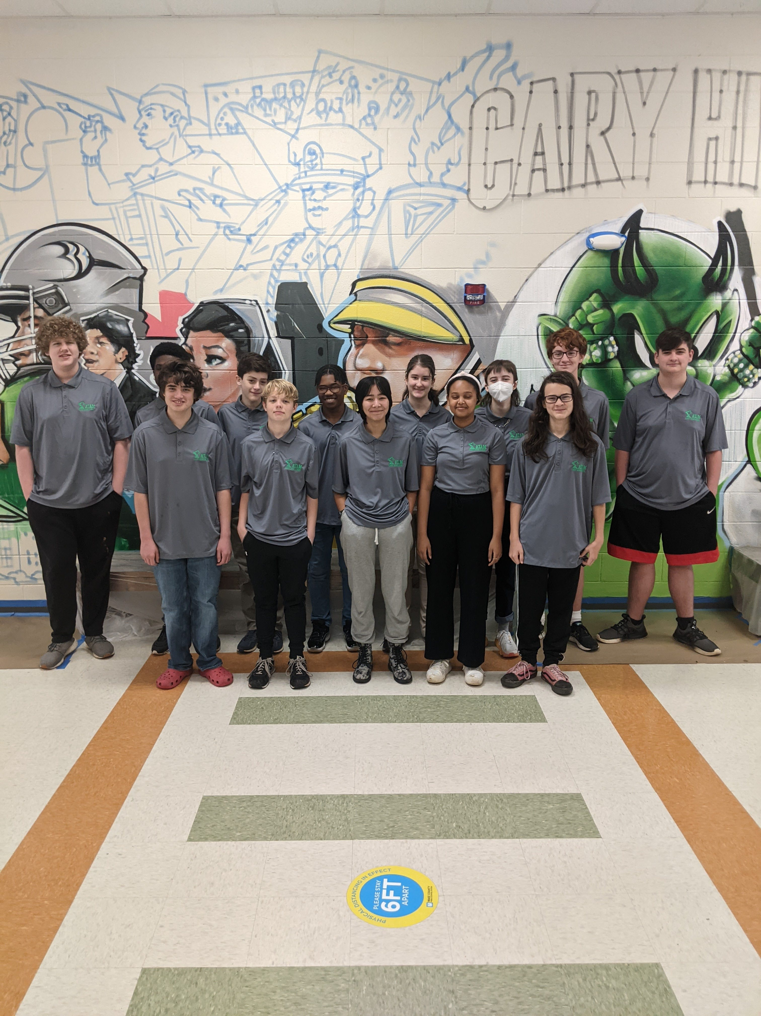
Academy Students

Slide 12
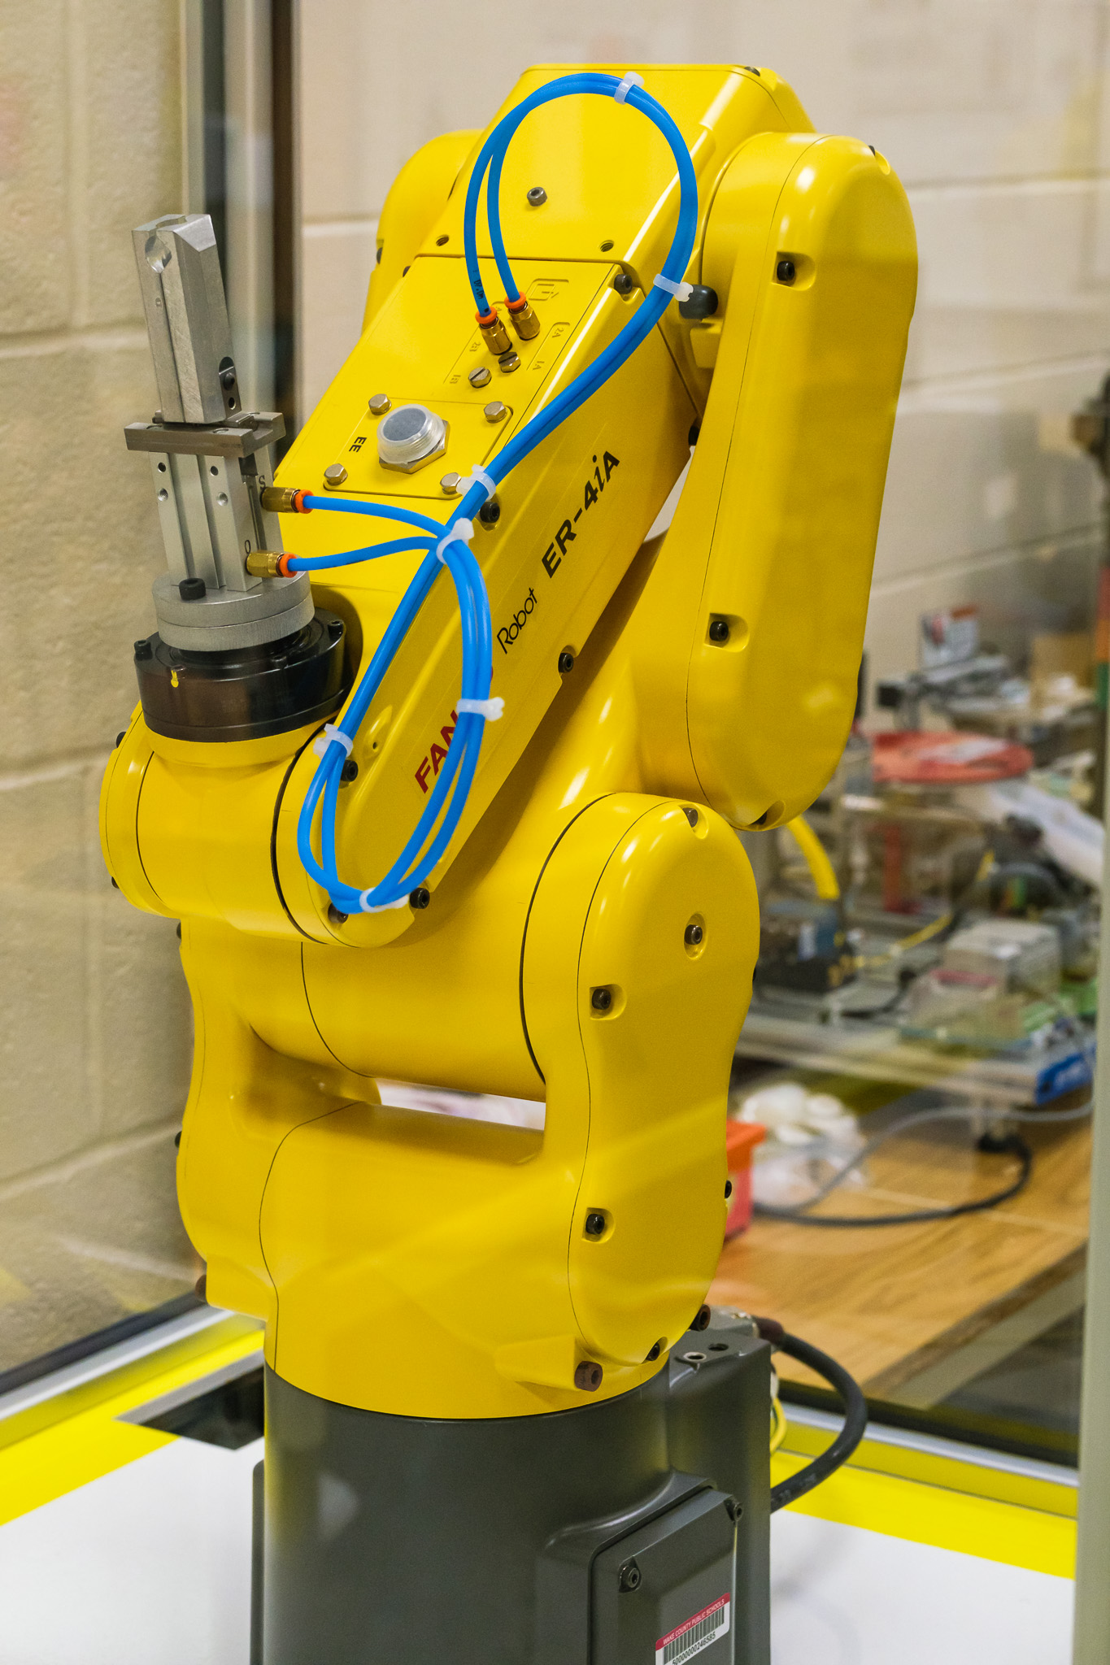
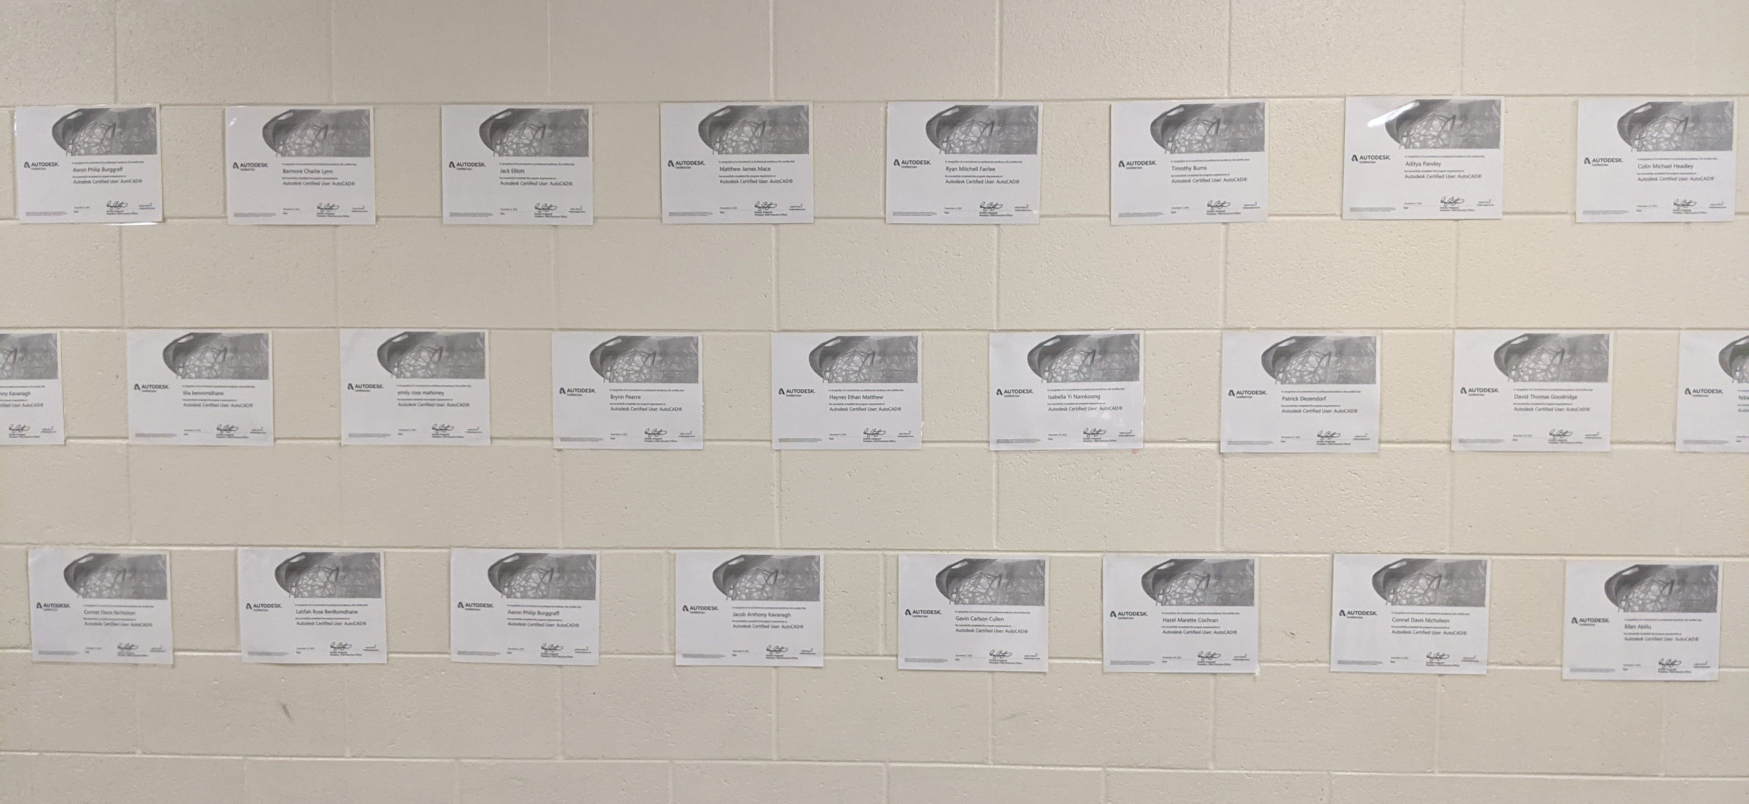
Opportunity for your child to Learn & Earn:
Earn Industry recognized certs that will boost their earnings power!!
Learn employability and soft skills that will put them ahead of their peers!!
Learn high demand technology, design, engineering and manufacturing skills!!

Slide 14
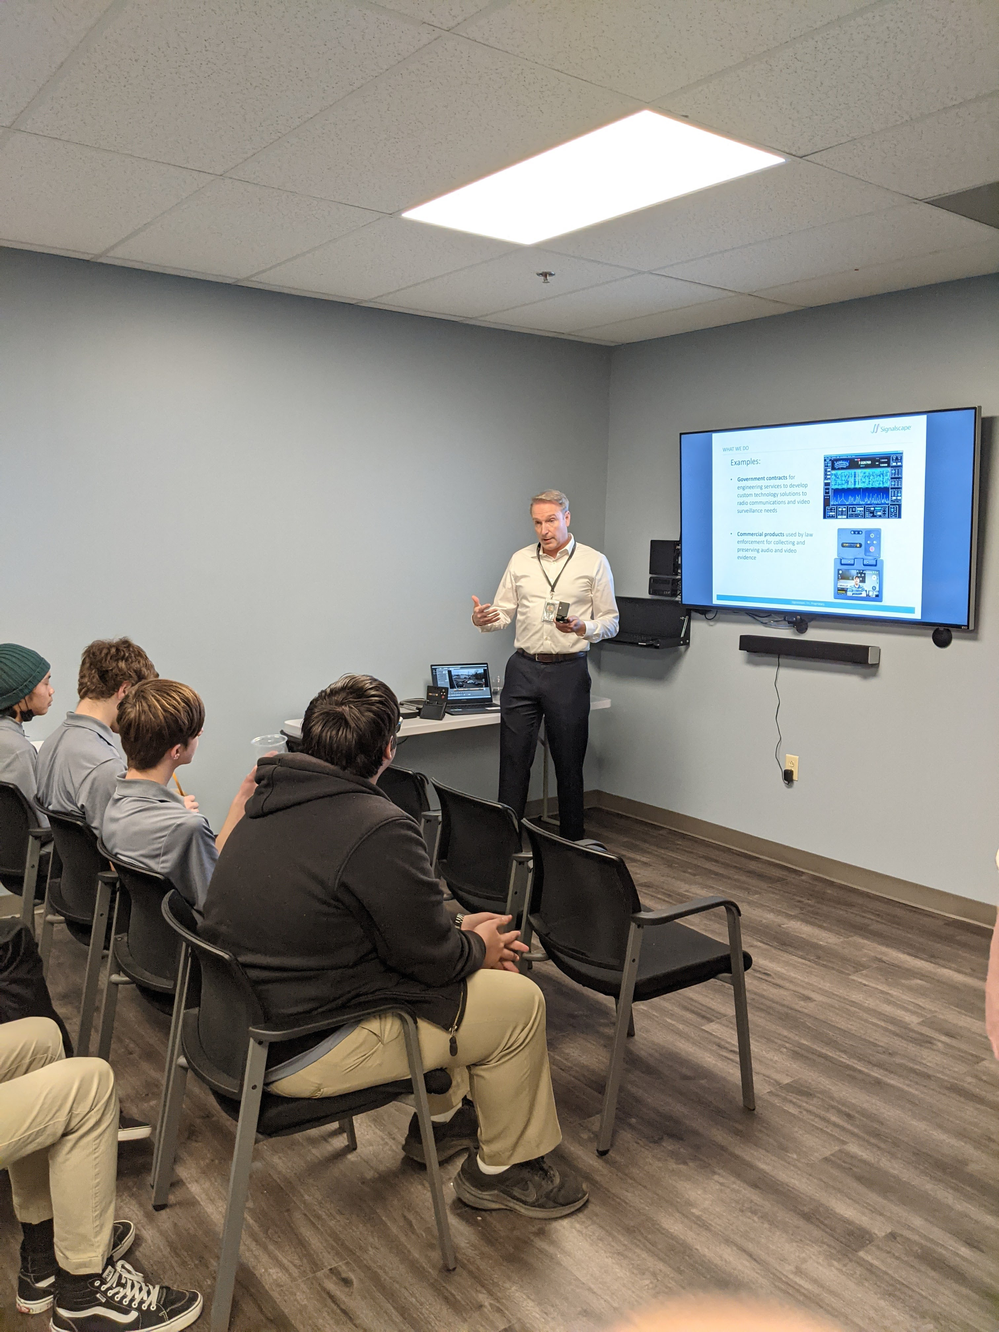
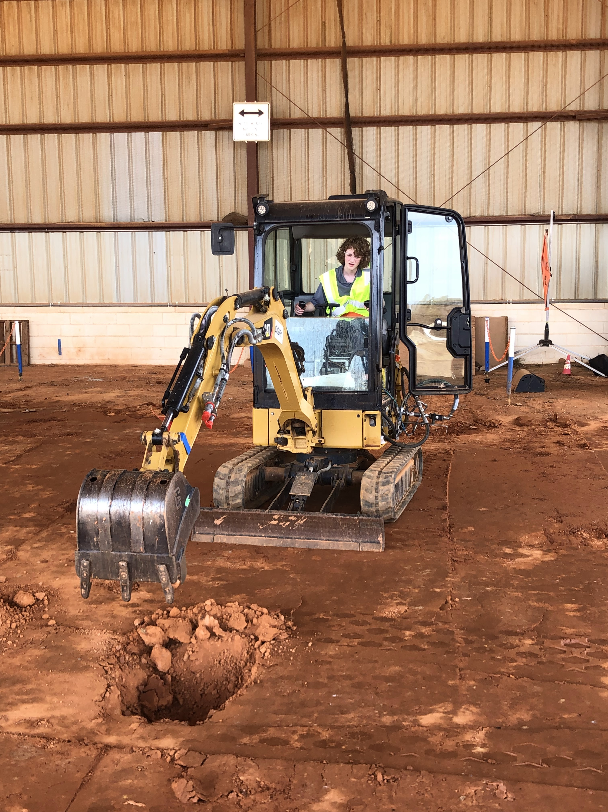
Job Shadow Day

Slide 15
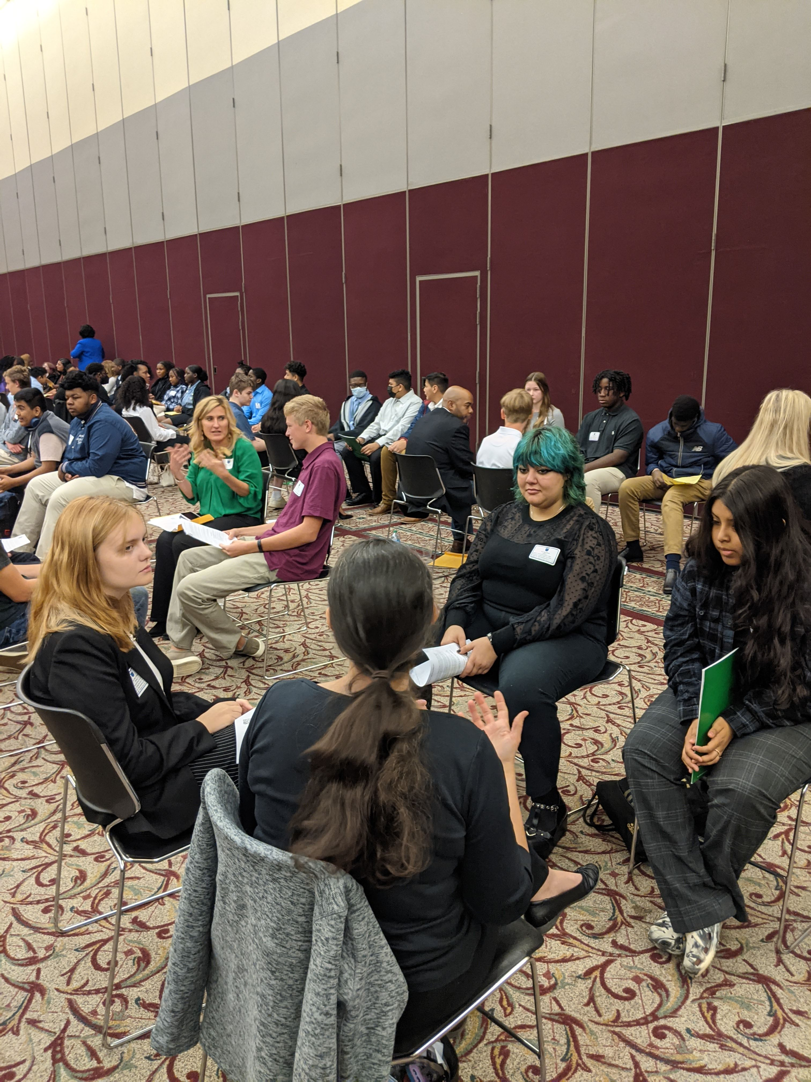
County Career & Networking Event

Slide 16
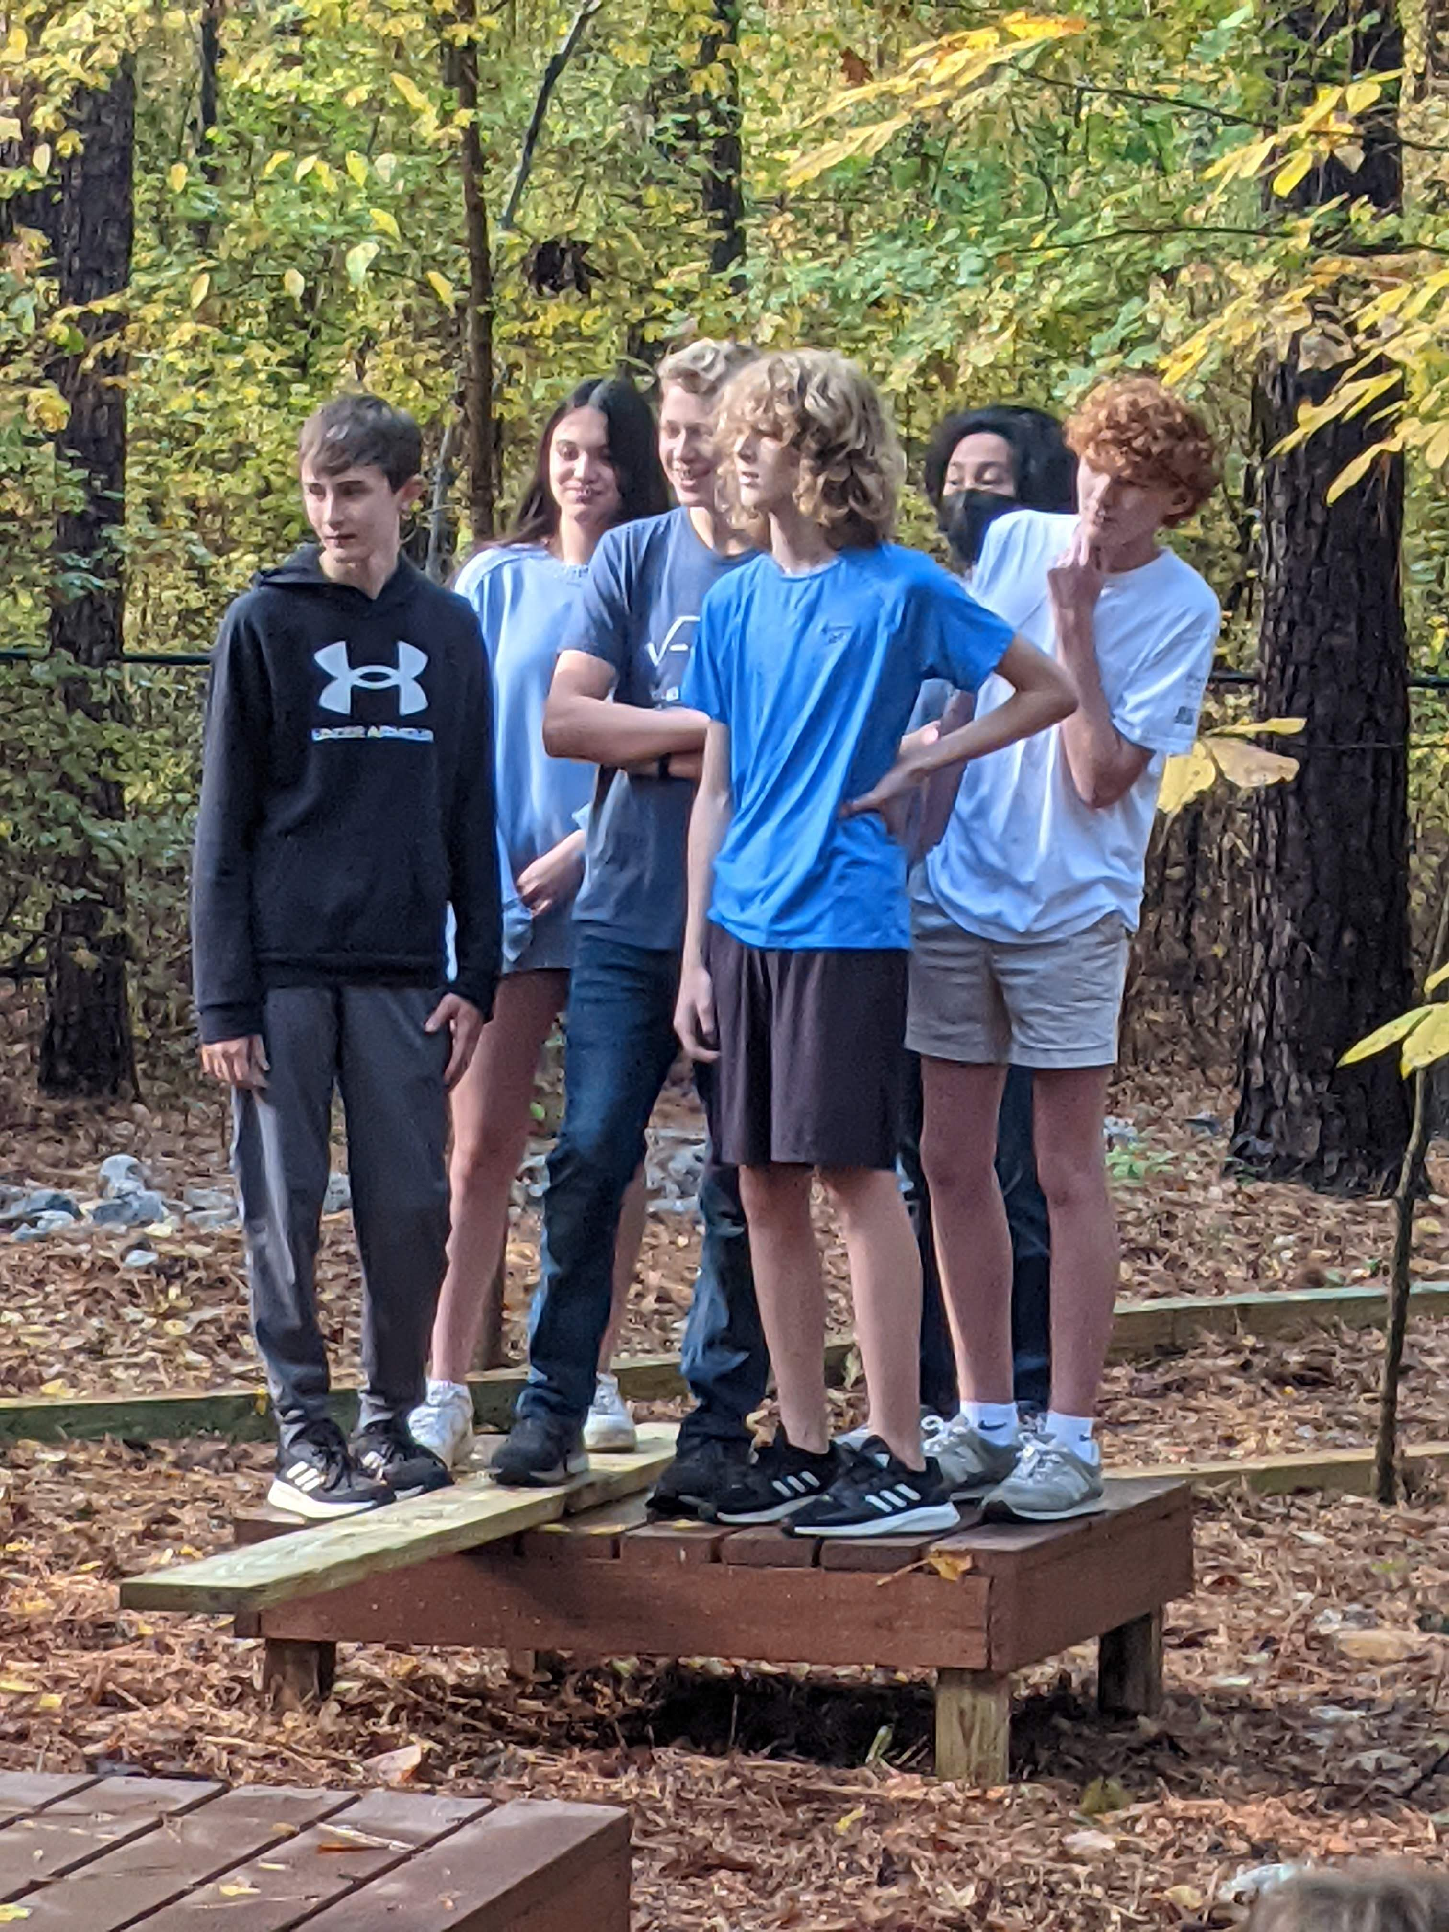
Low Ropes Team Building

Slide 17
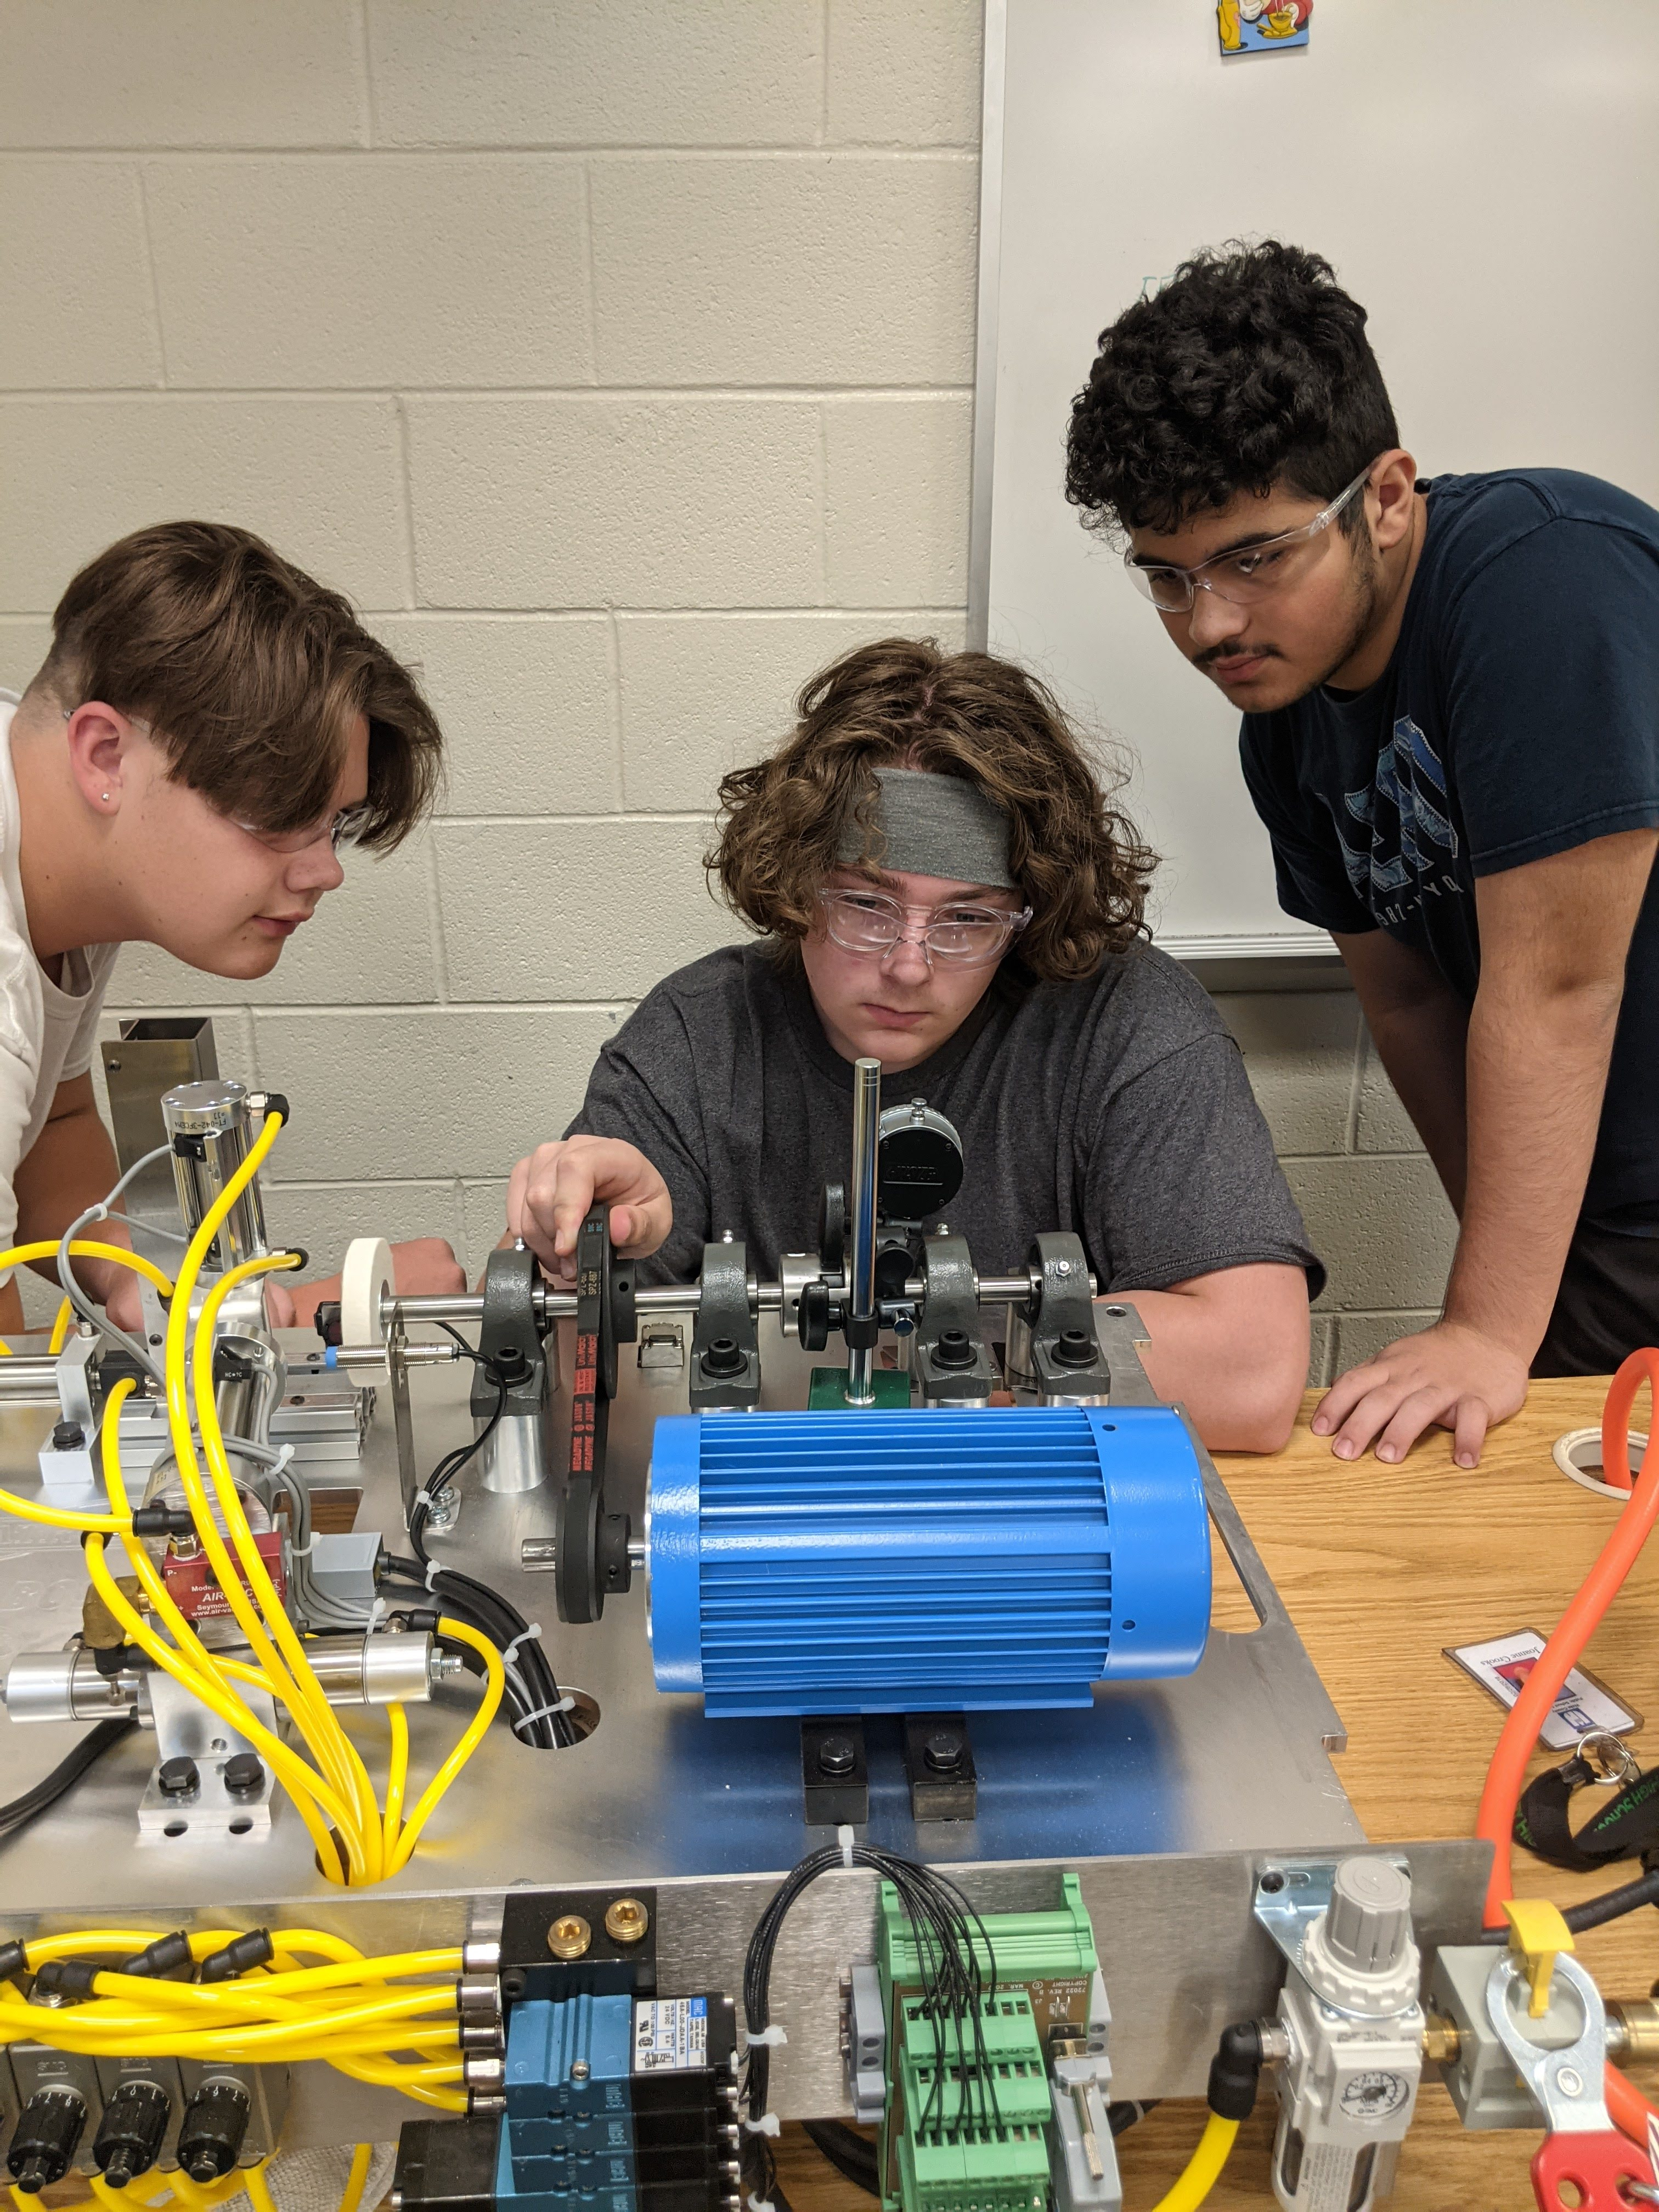
ATAM Tech

Slide 18
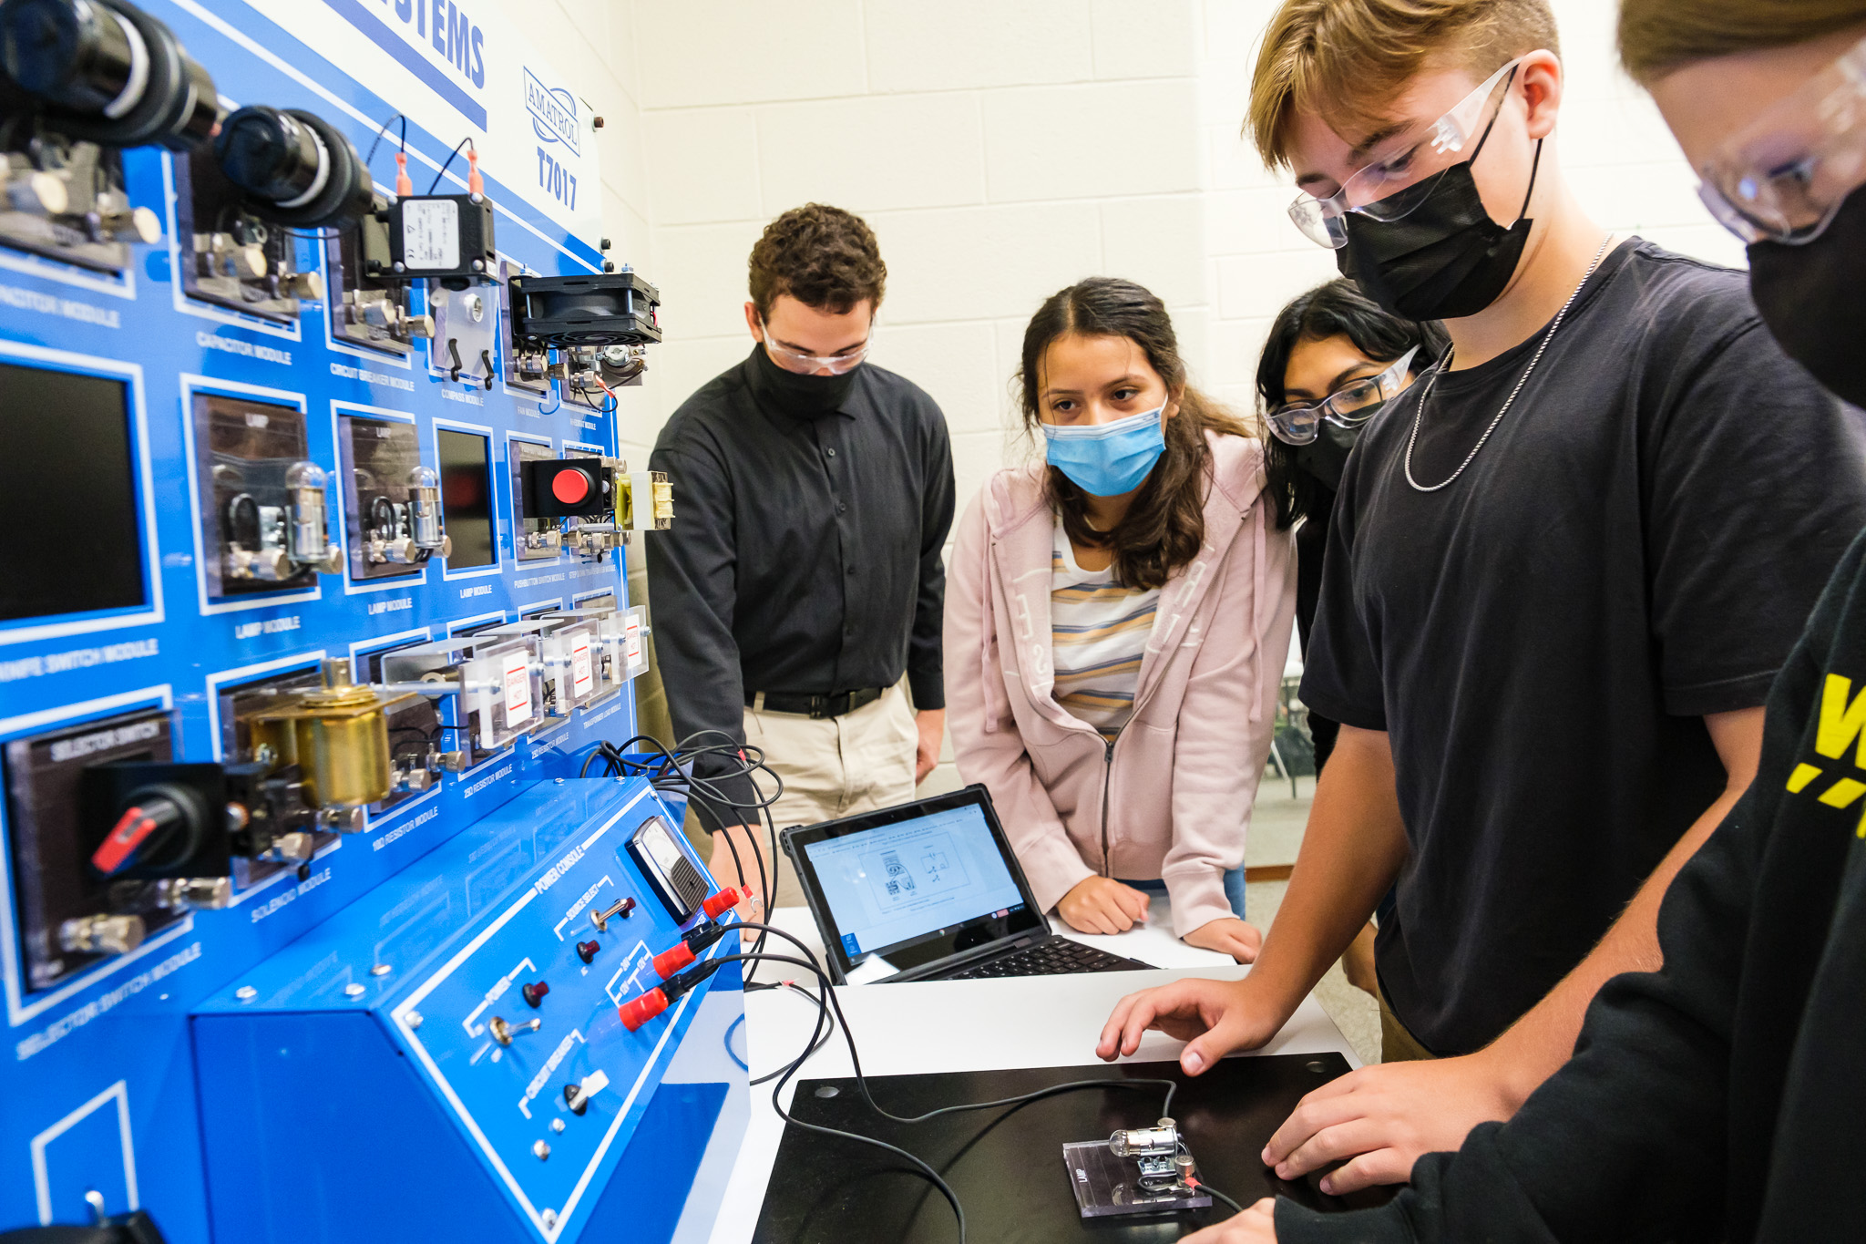
ATAM Tech

Slide 19
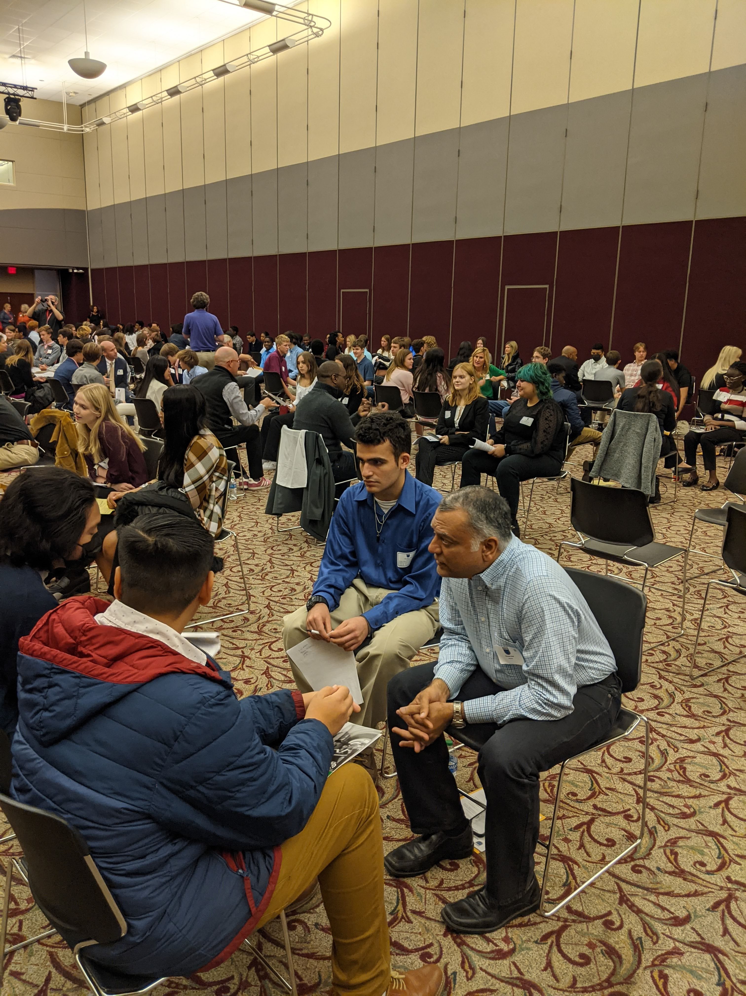
Because of this Opportunity Students Will:
Have access to a professional network!!
Participate in fieldtrips and unique learning opportunities!!
Learn to think critically and problem solve!!
Be part of a group that is like family!!!

Slide 20
Drafting 1 Egg Drop Project

Slide 21
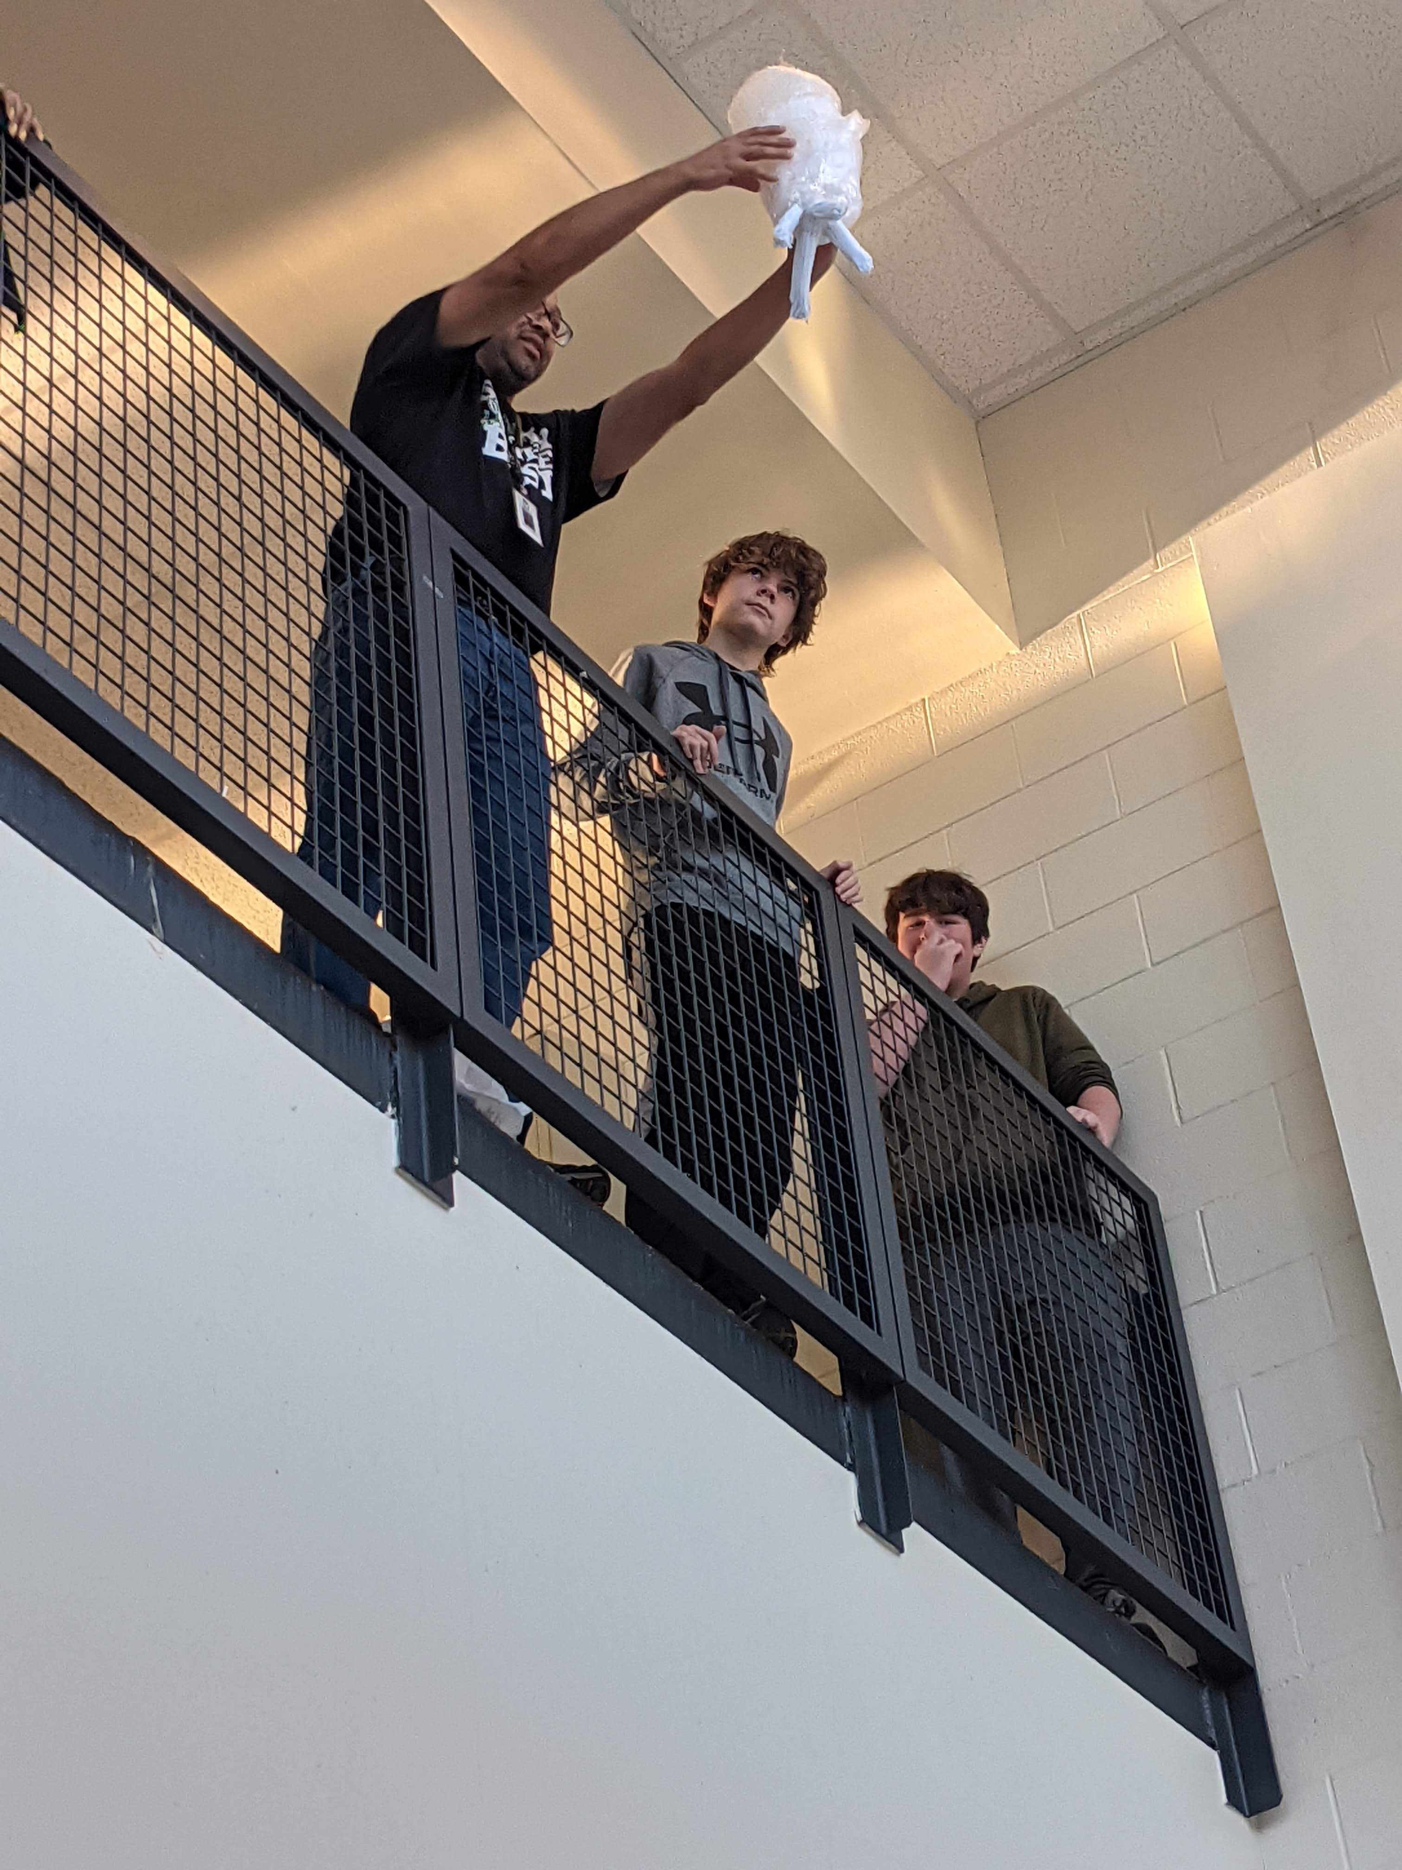
Drafting 1 Egg Drop Project

Slide 22
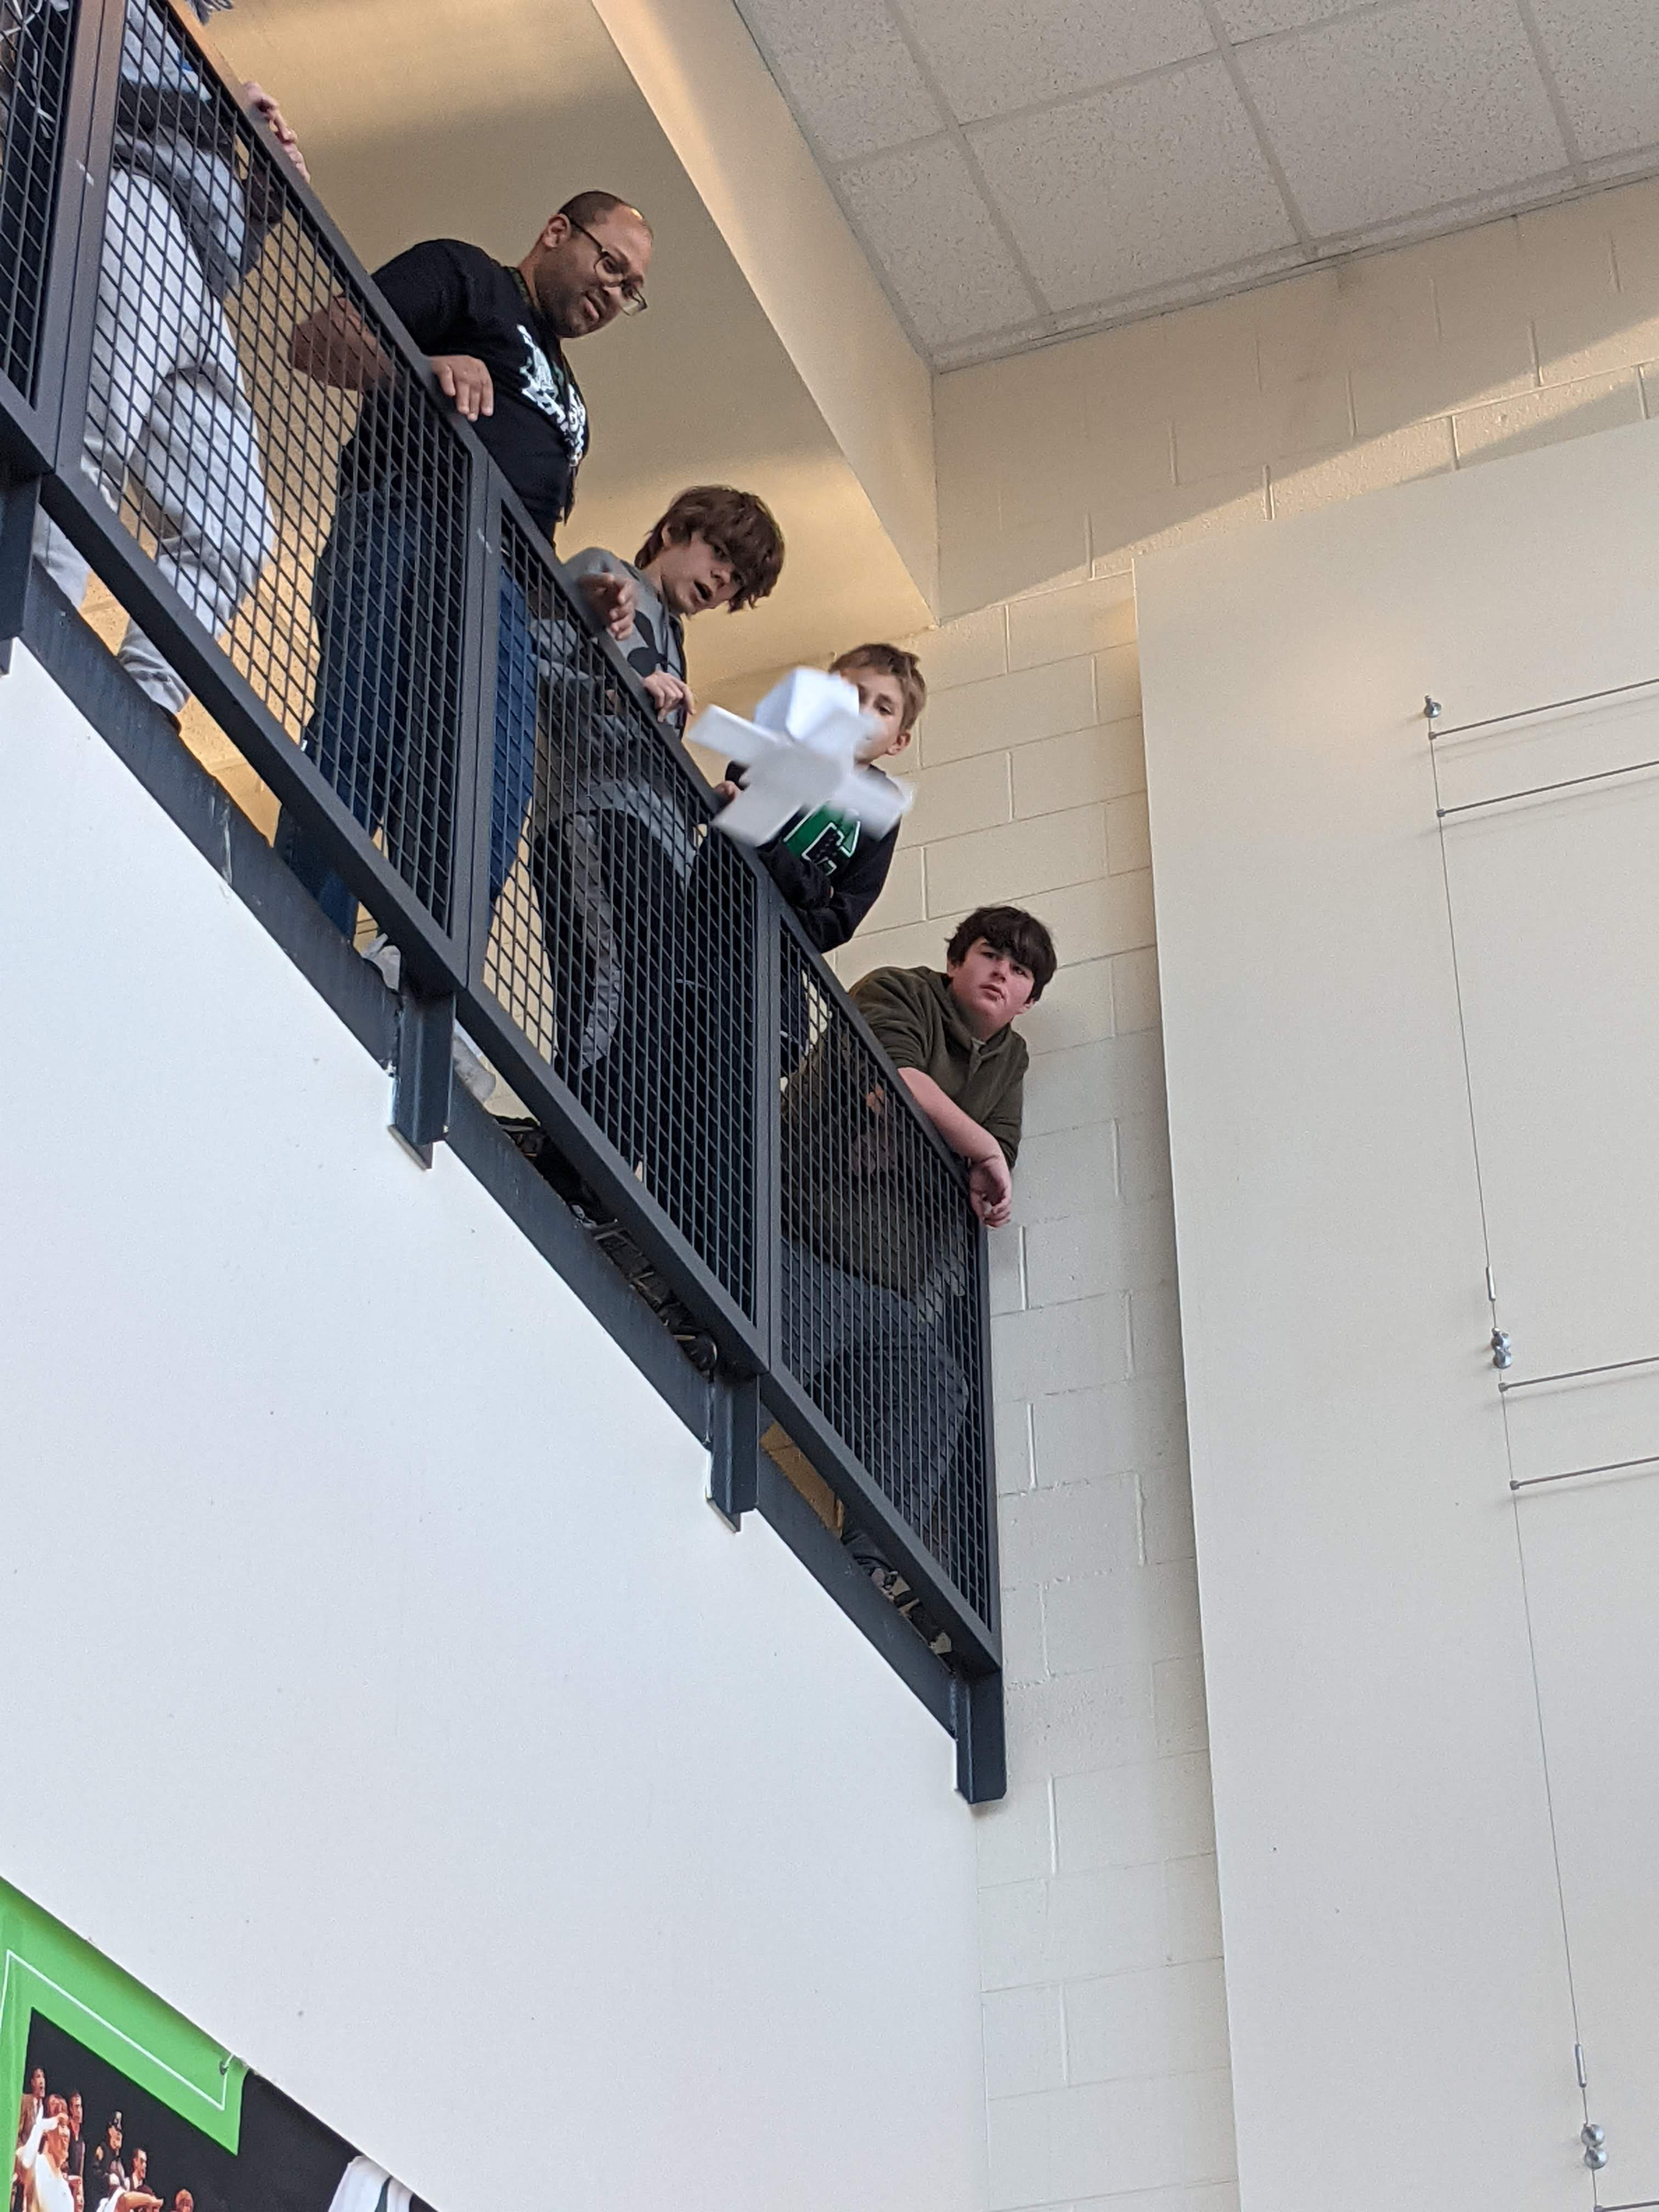
Drafting 1 Egg Drop Project

Slide 23
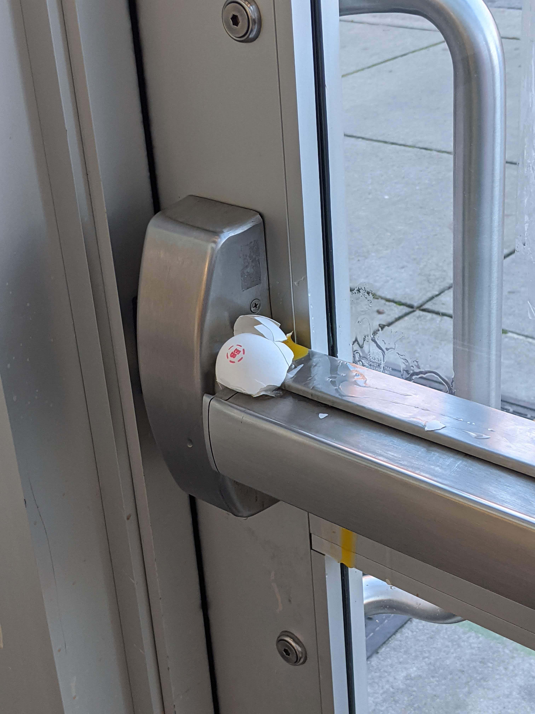
Drafting 1 Egg Drop Project

Slide 24
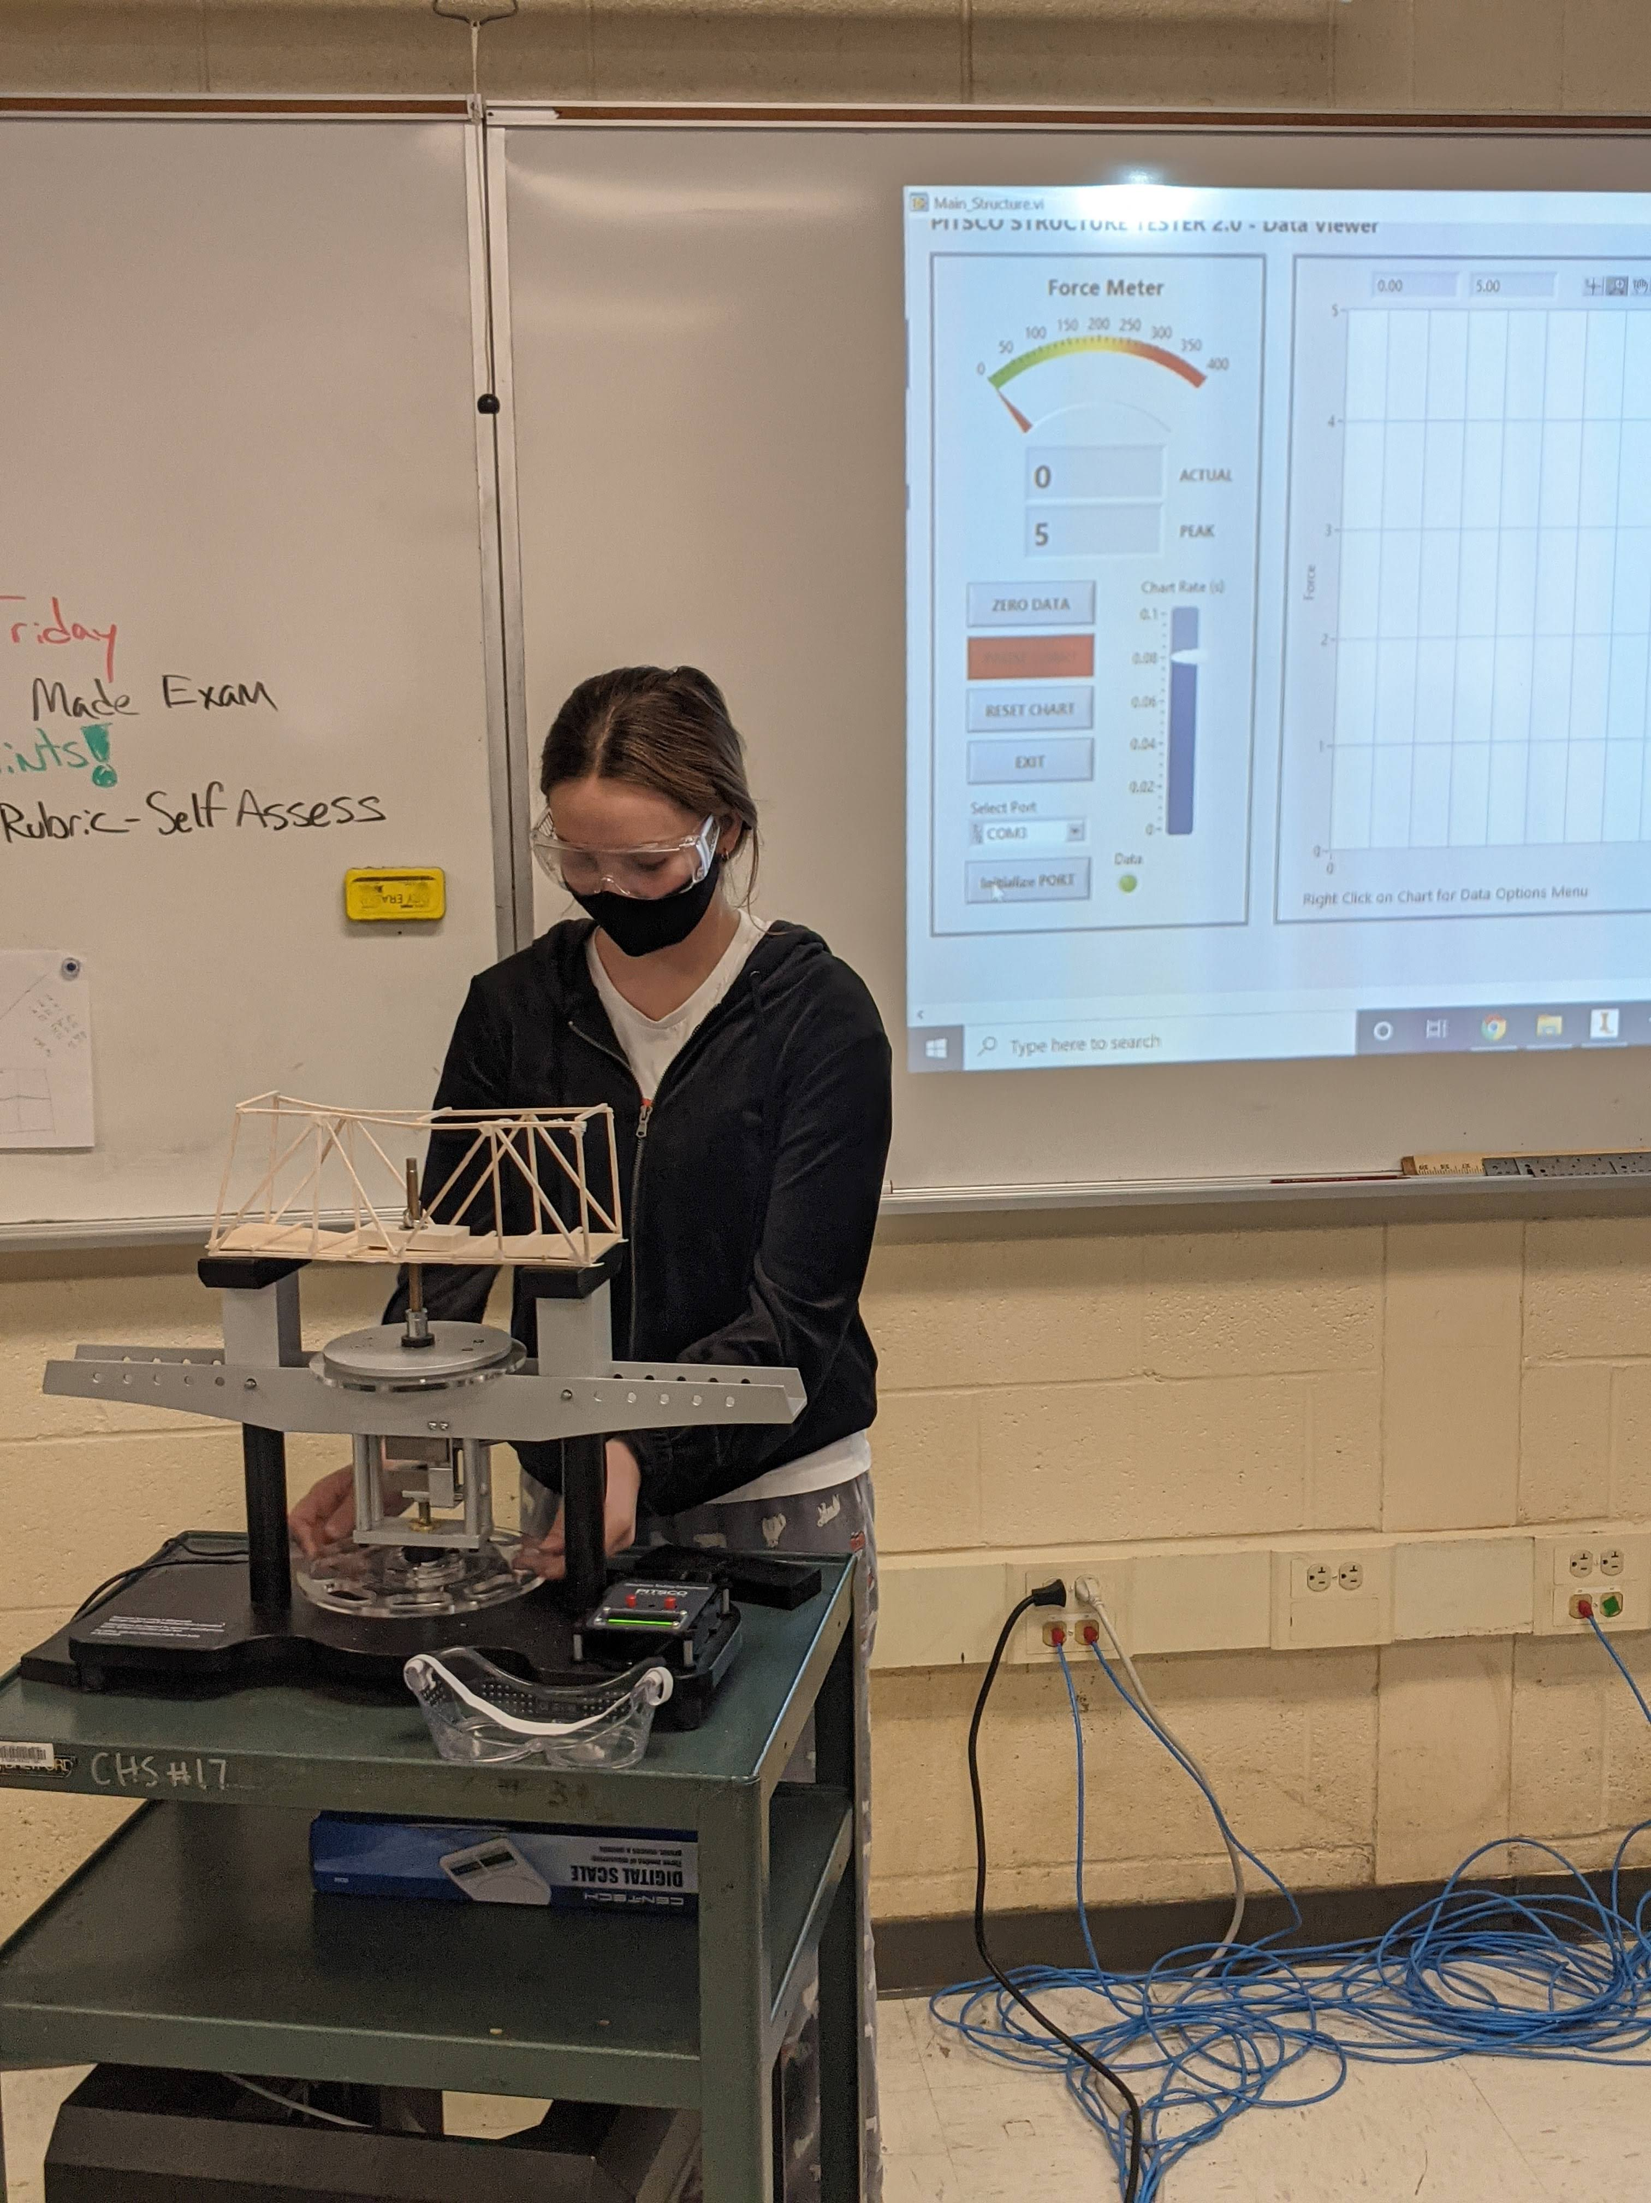
ATAM Tech

Slide 25
Because of this Opportunity Students Will:
Have access to internships and apprenticeships!!
Have access to well paying jobs upon graduation!!
Be prepared for career, college or whatever your next steps are!!
Have fun and leave the academy a more confident prepared person!!

Slide 26
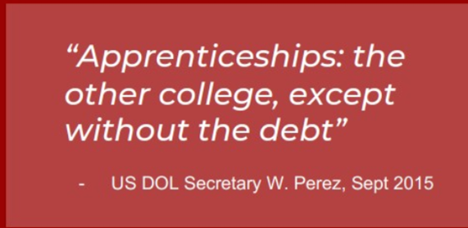
Free College! Get Paid While You Go To School!

Slide 27
Free College! Get Paid While You Go To School!

Slide 28
Being in an Academy Translates Into Success!!

Slide 29
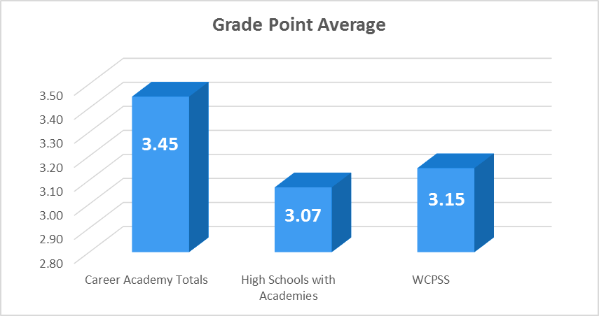
Being in an Academy Translates Into Success!!

Slide 30
What ATAM Expects of It’s Students:
Students Who:
Are interested in STEM & Advanced Manufacturing
Committed to a four-year program.
Want to learning in a collaborative fun environment
Have an open mind and want to learn how to problem solve
Learn skills that make them employable upon graduation
Who want to get a head start on a successful career

Slide 31
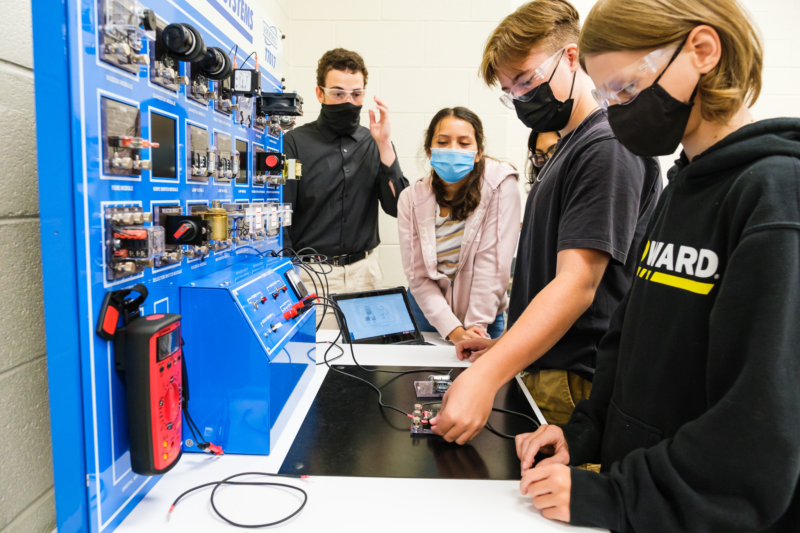
ATAM is Taking Applications to This Exciting Program Now!
If you are interested in being part of this exceptional program or need more information to make an informed decision scan the QR Code below or contact Mr. John Evans via email at jevans3@wcpss.net
Academy Director – John Evans
Email: jevans3@wcpss.net Cary High School
919 460-3549 Ext. 21832

Slide 32
Scan To Learn More About The Academy
I Hope You Will Join Us!

